Slide 1
Strategy
Session 7 : Business Strategy

Slide 2
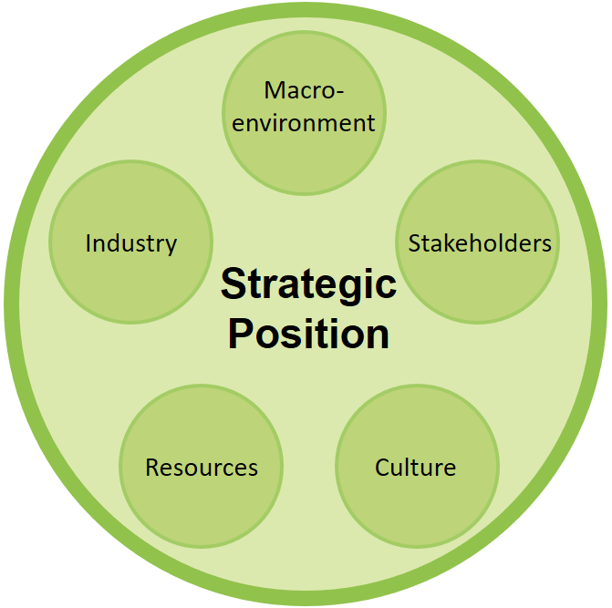
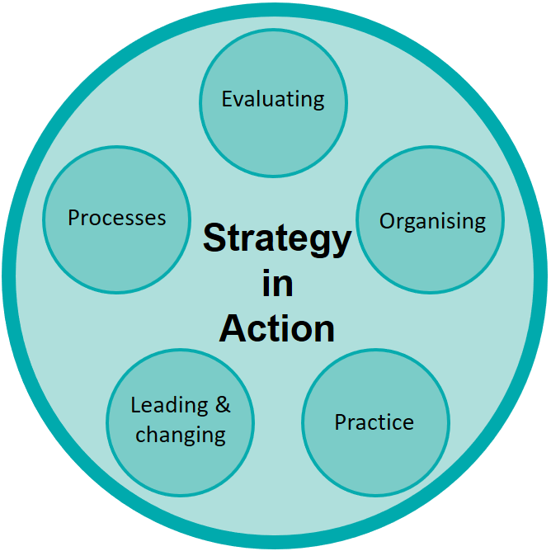
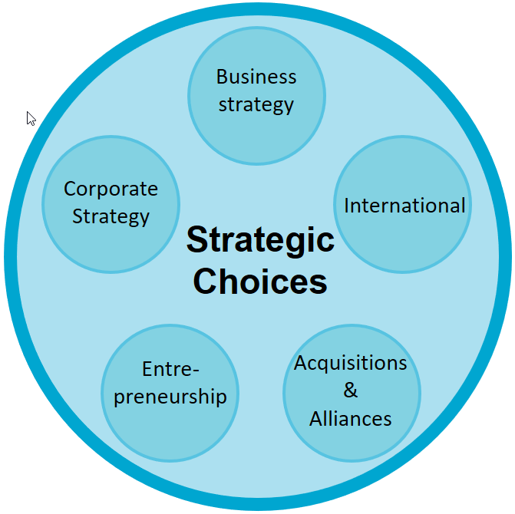
Overall view

Slide 3
Strategic Choices
Business strategy
Sessions 7-10
Strategic choices involve understanding the underlying bases for future strategy at both the business unit and corporate levels and the options for developing strategy in terms of both the directions and methods of development.
What business to include in portfolio?
How do our businesses compete?
How should we compete internationally?
Are we innovating effectively?
Is non-organic growth important?
Corporate Strategy
International
Strategic Choices
Entre-preneurship
Acquisitions & Alliances

Slide 4
Strategic Choices
Business strategy
Sessions 7-10
Strategic choices involve understanding the underlying bases for future strategy at both the business unit and corporate levels and the options for developing strategy in terms of both the directions and methods of development.
What business to include in portfolio?
How do our businesses compete?
How should we compete internationally?
Are we innovating effectively?
Is non-organic growth important?
Corporate Strategy
International
Strategic Choices
Entre-preneurship
Acquisitions & Alliances

Slide 5
Business Strategy

Slide 6





Strategic Business Units
At the corporate level, companies need to decide in which areas they wish to compete.
Fresh Dairy (52%)
Water (20%)
Medical Nutrition (7%)
Baby (21%)
An SBU supplies goods and services for a distinct activity. (note : in French, we often refer to a DAS – Domain d’Activité Stratégique)
Defined by market (channels, customers, ….) or capabilities

Slide 7
Key questions
How will we compete ? – our competitive strategy
How will we « capture value » ? – our business model

Slide 8

Competitive strategy
Competitive strategy is about how a company, business unit or organisation acheives competitive advantage in its domain of activity.
Competitive advantage is about how a company, business unit or organisation creates value for it users which is both greater than the costs of supplying them and superior to that of rivals.
« Competitive » - we can effectively compete by creating perceived value that is greater than costs.
« Advantage » - we have a perceived value that is greater than our rivals.
When two or more firms compete over the same market, one firm has a competitive advantage over its rivals when it earns (or has the potential to earn ) a persistently higher rate of profit / level of performance

Slide 9


Competitive Advantage
2 fundamental means to establish competitive advantage (M.Porter)
Lower cost (cost advantage) than competitors
Careful – this refers to the costs of production.
We are THE low cost provider (attention : you must be the LOWEST or else your at a competitive disadvantage)
You can’t disregard quality and norms – respect market standards and norms (style safety, etc.)
Differentiation from competitors
We offer something different
Differentiation allows us to have higher prices
Ex. We have a high quality product – this increases costs – but e can sell for a higher final price as the value from high quality is perceived by the customer

Slide 10


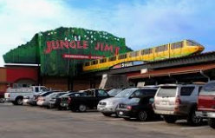
Competitive Scope
Competitive a strategies can be applied at different « scopes »
Broad targets
Example : Kroger is the largest supermarket chain in USA (5th in world) with locations and large product range ( Base in Cincinnati, Ohio – USA)
Narrow targets
Example : geographic scope, customer segments (youth), etc.
Small local grocery stores like West Point Market or Jungle Jim’s

Slide 11
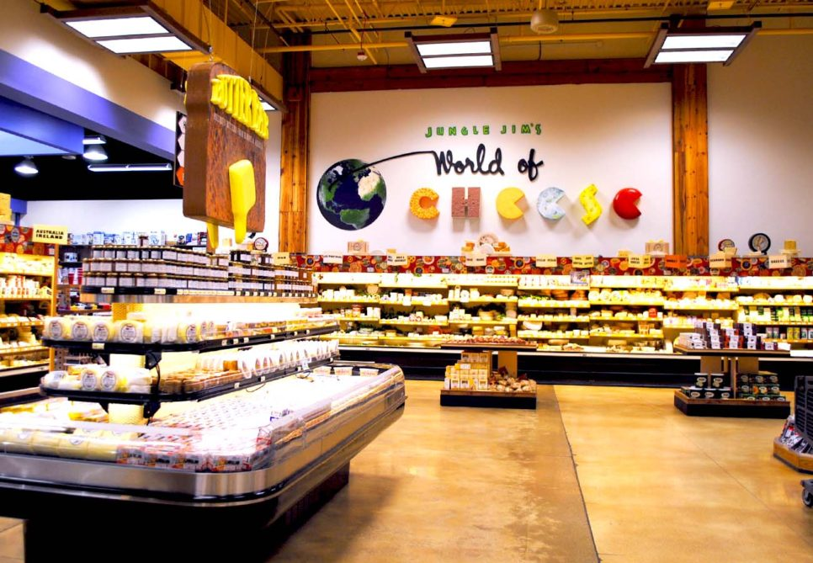
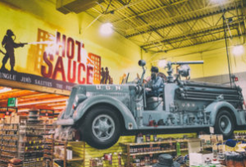
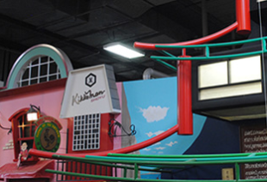
Jungle Jim’s
Speciality foods
180,000 items, about 60,000 of which are international items, and over 300,000 square feet (6½ acres or 26,000 square meters) of floor space.
1400 cheeses
Jungle Jim's is notable for one of the largest wine collections in the United States, live seafood tanks, and an in-store cooking school. Each week, the store is visited by approximately 82,000 shoppers (foodies).
Many of the specialty foods in the store's Asian and European departments are difficult to find elsewhere in the Greater Cincinnati area, and customers have been known to drive from other cities for the store's wide variety of food.

Slide 12
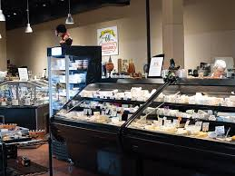
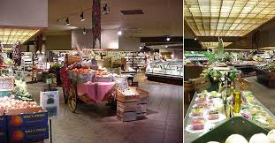
West Point
Specialty foods
Catered to high income families in local area
VERY HIGH service quality (personalized)
International products, wines, etc.
“We are a Specialty Foods Store with house made chef's case items, bakery, wine, imported chocolates and specialty foods”.
West Point wine director Bill Krauss said the store couldn’t remain viable as a single-store operation amid increased competition in the larger specialty/gourmet food retailing business.

Slide 13
Generic Strategies
Competitive Advantage
Low cost
Differentiation
1 Cost Leadership
2 Differentiation
Broad Target
Competitive Scope
3a Cost focus
3b Differentiation focus
Narrow Target

Slide 14
Cost-leadership
Cost-leadership involves becoming the lowest-cost organisation
Some ways to do this
Input costs
Economies of scale
Experience
Product/process design

Slide 15
Cost Leadership
Scale (Economies of Scale)
Cost per unit
Size differences and economies of scale
Volume and size of machines
Volume and cost of plant and equipment
Employee specialization
Volume and overhead cost (per unit)
Diseconomies of scale are possible !
Physical limitations (cement kilns can only be so big)
Managerial diseconomies
Worker demotivation
Distance (centralized production means increase transport costs)
Quantity
Increasing returns to scale
Constant returns to scale
Decreasing returns to scale

Slide 16
Cost Leadership
Experience and Learning
Cost per unit
As we produce more over time we get better at what we do
We improve our work methods
Note : to increase over time, market share may need to grow – this could be costly (advertising, marketing mix)
Cumulative Quantity over time

Slide 17
Cost Leadership
Other factors
Differential low-cost access to factors of production
Ex. access to low cost fuel sources
Ex. Access to know how and trained people (build company in Silicon Valley)
Technological advantages not linked to scale
Ex. use the latest technologies
Product Design and whole life costs / use costs
Note : are there first-mover advantages to cost leadership? Learning – is experience required? Can others easily learn from your mistakes? Technology – move later and get better technologies? First mover may be limited by old tech.

Slide 18
Cost Leadership and VRIO
More likely to be rare
Learning curve economies (especially in emerging industries)
Differential access to low-cost factors of production
Some technologies (protected)
More likely to be inimitable
Differential access to low-cost factors of production
Protected or « complex » technologies
Learning (if history is required for learning)

Slide 19
Exploiting Low Costs
What do you do with low cost?
Differentiator
Price
Proximity strategy requires benefits/features that are CLOSE to rivals (lower quality- but not too much)
Profit
Cost leader with parity
Cost leader with proximity of features
Average
Costs
Profit
Profit
Profit
Costs
Costs
Costs

Slide 20
Differentiation
Differentiation strategy involves uniqueness (perceived) along some dimension that is sufficiently valued by customers to allow a price premium
Product features or attributes or performance (note : perceived!)
Linking value chain components (product + service)
Perceived or real 1st mover advantage – set the standard, « oldest »,..
Location
Links with other firms (complex offer that involves other value chains)
Product mix & variety (one stop shopping)
Brand reputation
Customer relationships
Product complexity or customization (go beyond the « core » or « expected » product)

Slide 21

The « Total product »
Core or generic product
Expected product Core+minimal purchase conditions (e. warranty)
Augmented product Things customer has not thought of (ex. features)
Potential product Other ways to attract/hold – unused opportunities

Slide 22



Differentiation and VRIO
Inimitability is possible for
Product/service complexity (links across functions, with partners, etc) - complements
Reputation
Location
First mover
Unique access to supply/distribution channels
Unique resources used to create unique product features
Customization & customer relationships (responsive, good service,..)

Slide 23
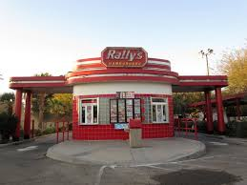

Focus
A focus strategy targets a narrow segment or domain of activity and tailors its products or services to the needs of that specific segment to the exclusion of others
Look for « niche » weaknesses of firms with a broad strategy.
Serving target better than others that are covering a broad scope
Broad scope may be a cost disadvantage – produce many products ex. Rally’s drive-in reduced menu offers cost advantage
Specialized knowledge for a focused offer helps differentiate (ex. Curves mastery of womens’ needs, specific structure)
Success based on
Distinct segment needs (clear lines of demarcation)
Distinct segment value chains (especially if cost focused)
Viable segment economics

Slide 24
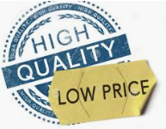
Can you do BOTH ?
Cost AND Differentiation ??
Can you do both effectively ? Risks ?
Maybe possible … if separate business units used (ex. Air France + Transavia)
Innovations that allow cost and quality improvements simultaneously (internet retailing innovations, TQM)
Competitive failures (others are also « stuck in the middle » and your competitive disadvantage can persist)
If a firm dominates, relative performance may be less important.
Be careful as the two are hard to combine

Slide 25
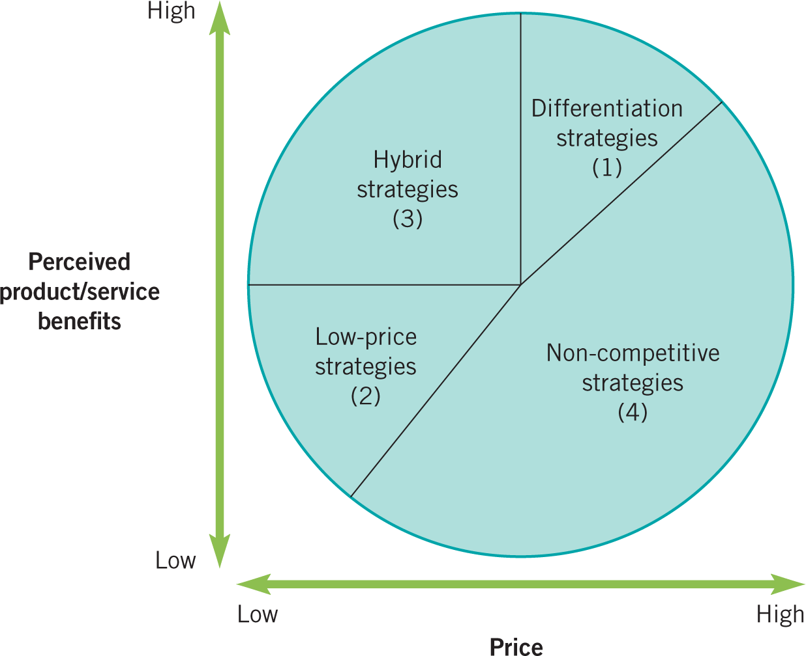
The strategy clock
Looks at potential hybrid strategies
Uses PRICE (not cost)
Incremental vs discrete choices available.

Slide 26
The strategy clock
Differentiation without price premium (gain market share) (short term)
Higher benefits and lower prices. Need cost advantages and differentiation. Entry strategy for innovators?
Differentiation with price premium
Focused. Reduced benfits and higher price. Low competition facilitates this
Low-price with « standard » features. Need low cost!
No frills. Low benefits and low cost (ex. Ryanair)
Not feasible (except for strong lock-in). Potential regulation

Slide 27
Cooperation

Slide 28
Cooperation
Competition can be bad for all rivals
Collaborate with some to « beat » others or fend off entrants
Formal (ex. cartels – illegal)
Informal (tacit collusion) (high barriers needed, similar offers, few competitors)
Collaborate to increase power over suppliers
Ex. Standardized specifications for parts
Collaborate to increase power over buyers
Ex. Keep prices high
Ex. Standardized features (helps lower « use » or « consumption » costs)

Slide 29

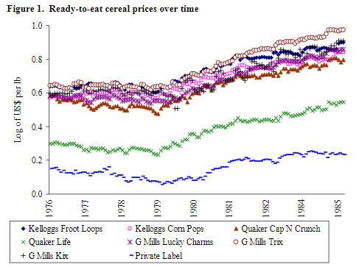



Tacit collusion in Breakfast cereals
Under scrutiny late 1970s
Large market share of top 4 (90%) and high profit margins (over 60%)
Strong brands and advertising created barriers to entry
Dismissed by Reagan administration 1981
Prices starting rising again
Don’t rock the boat (conscious parallelism)
Another example : airlines

Slide 30
Examples of Cartels caught in France
And what they were fined
Dairy product cartel — 192,7 M€
Franco German wheat cartel — 242,4 M€
Linoleum floor cartel (2017) — 302 M€ (Forbo, Gerflor & Tarkett)
Laundry detergent cartel (2011) — 367,9 M€ (Unilever, Procter & Gamble, Henkel & Colgate Palmolive)
Package delivery (2015) — 672,3 M€
Europe : MAN, Volvo/Renault, Daimler, Iveco, and DAF broke EU antitrust rules (2016) 3,807,220,000 euros !

Slide 31
Game theory
Consider competitors’ likely moves and what they imply for strategy.
Responses analyzed
Signals analyzed
Important when there is interdependence – outcomes of choices depend on choices made by the other ‘player’.
Ask yourself « what will my competitor do? »
Think forward and reason backward.

Slide 32
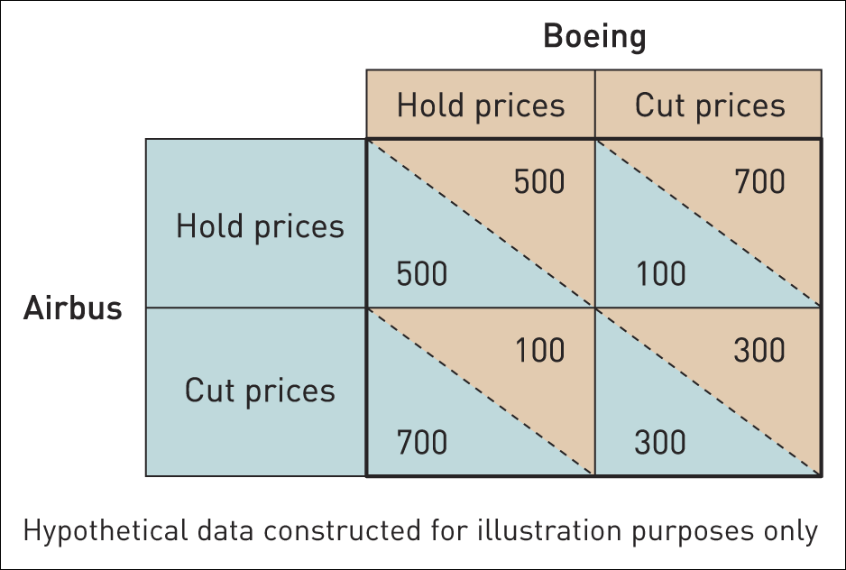
Prisoner’s dilemma payoff matrix
Cut prices ??
Boeing reflects
« If Airbus holds price, what is my best strategy to maximize MY payoff? »
« If Airbus cuts price, what is my best strategy to maximize MY payoff? »

Slide 33

Cooperation
Possible ?
Importance of repeated « rounds » (and no known « last » round)
Signal by responding quickly to deter future moves
Commit to a strategy
Some unilateral tactics exist to enforce cooperation

Slide 34
Business Model
A business model describes a value proposition for customers and other participants, an arrangement of activities that produce value, and associated revenue and cost structures
Value creation – what is offered, how and to whom - Customer needs and problems - Target customers and segments
Value configuration – how resources and activities are combined to create value - Key resources and activities (who does what) - Linkages
Value capture – cost and revenue streams and how value is recuperated (ex. pricing models)

Slide 35
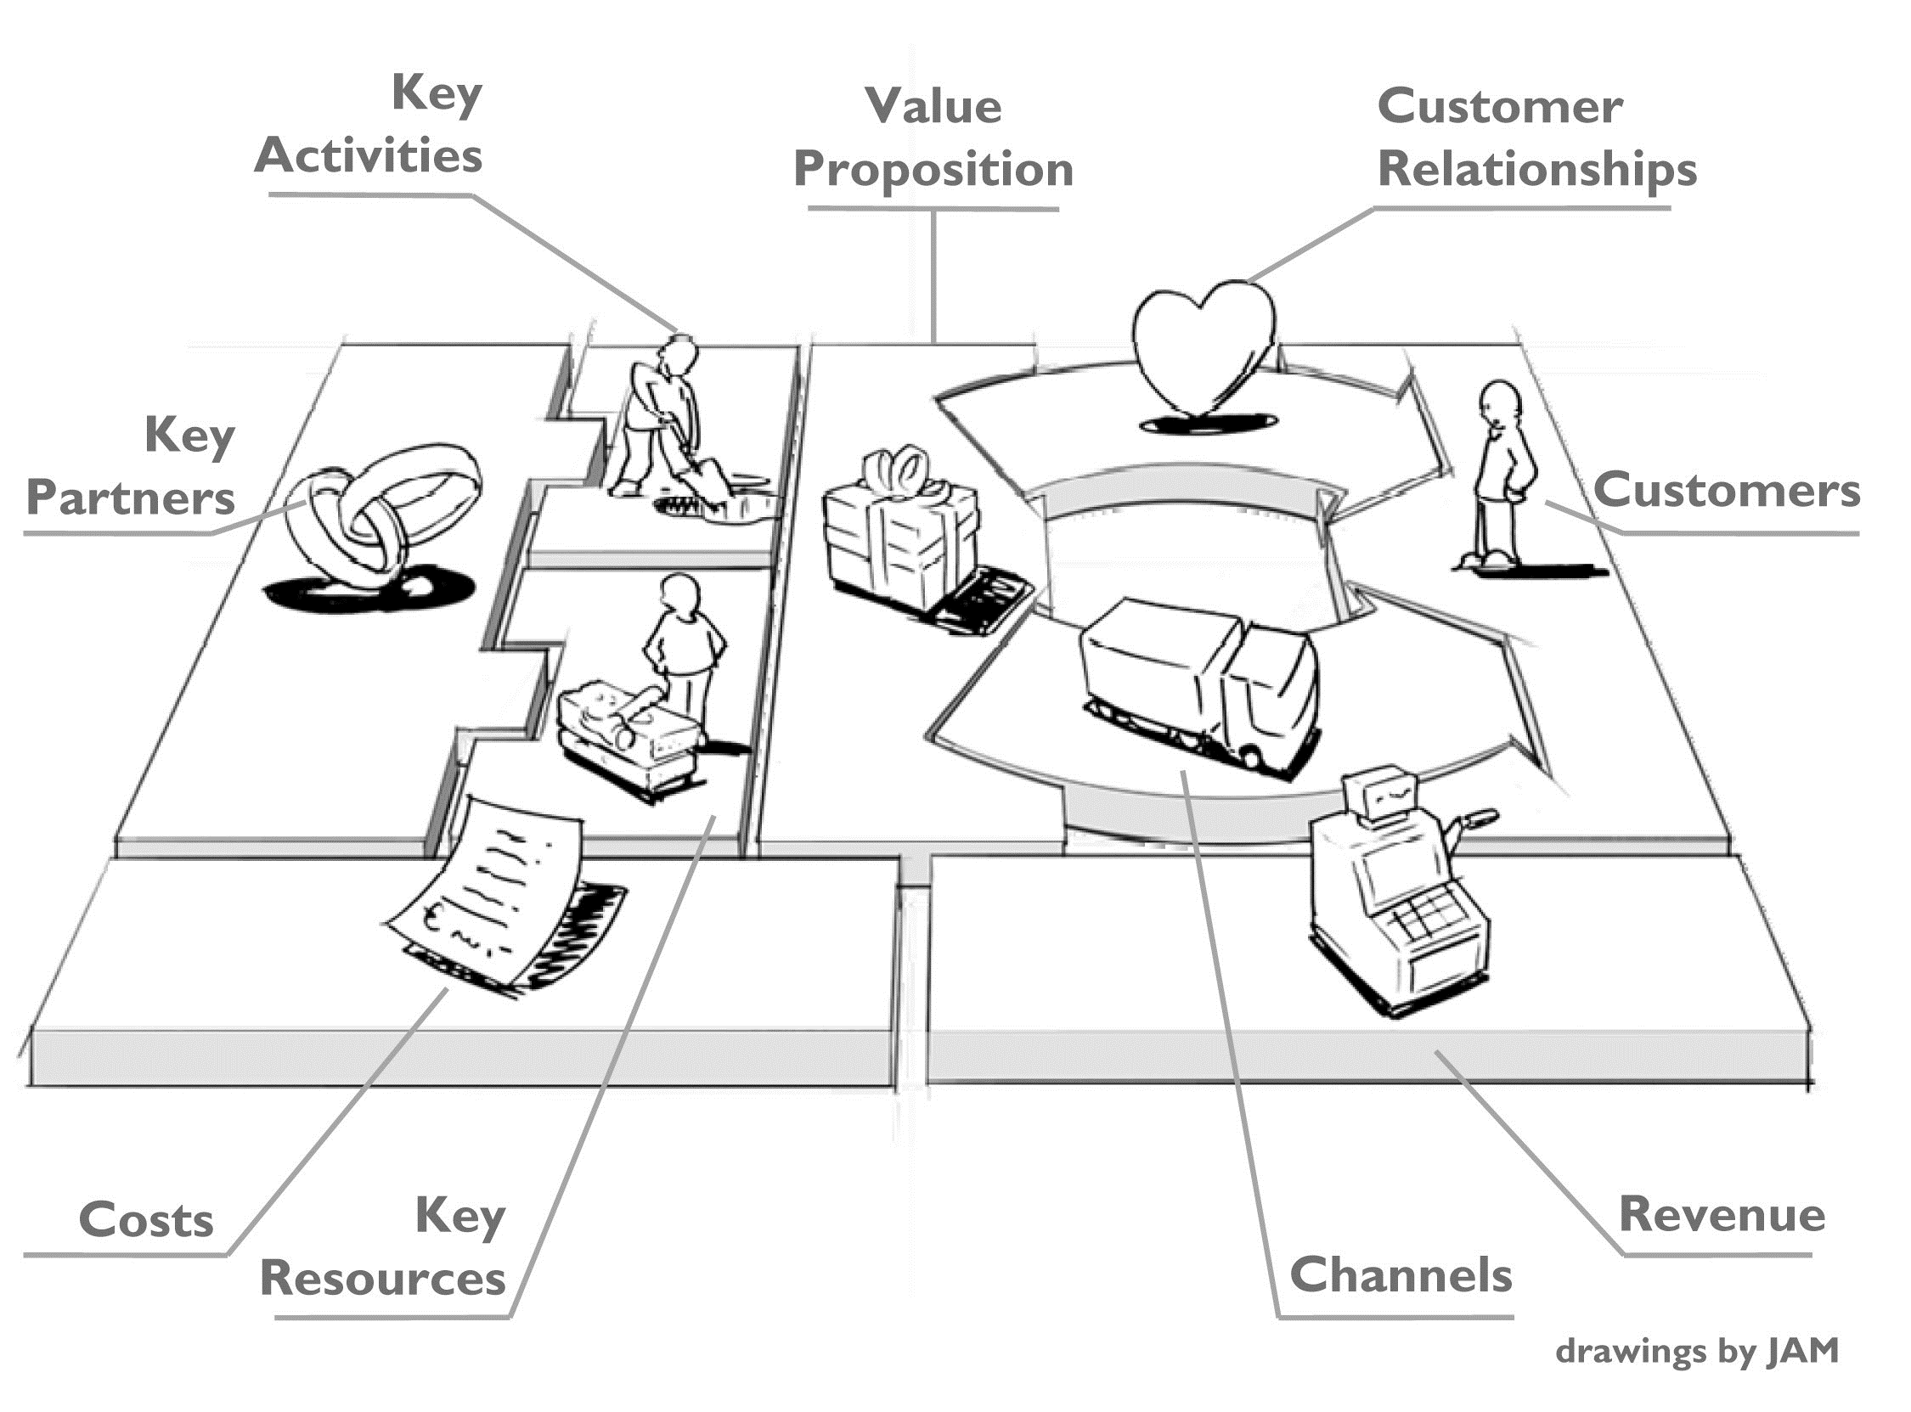
Busines Model Canvas

Slide 36
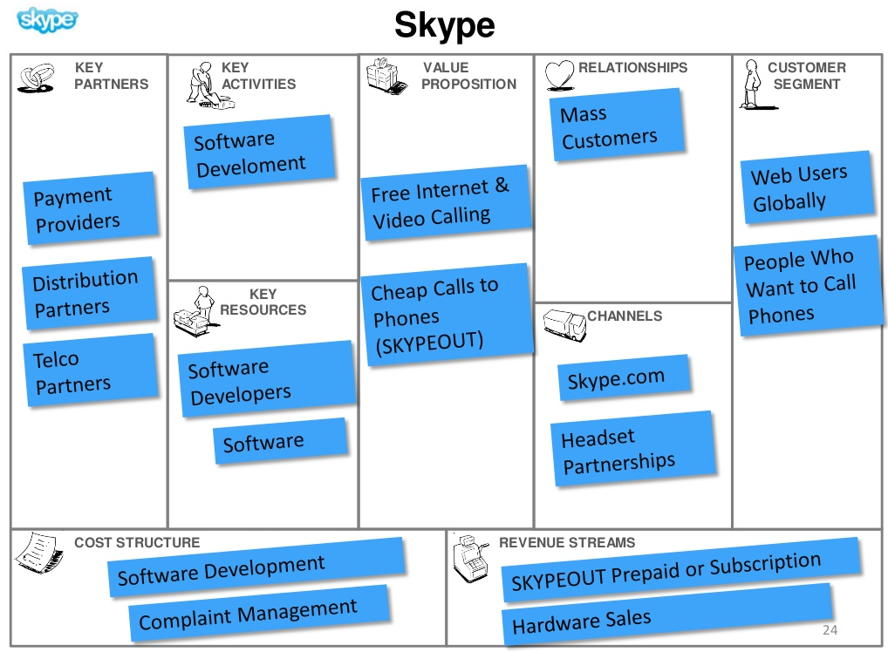
Skype

Slide 37
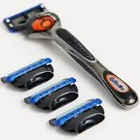
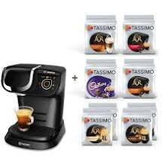
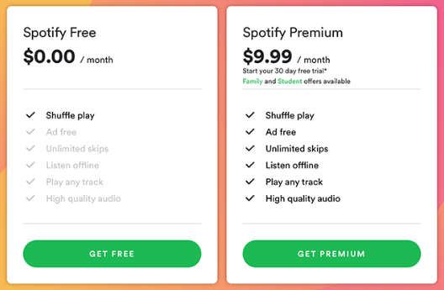

Typical patterns
Razor and blade
Low price razor, high price blade
Free phone, high price to call
Low price printer high price ink
Low price coffee machine high price coffee capsules
Freemium
Basic version is free
Skype, Spotify,…
Multi-sided platforms
Interdependence in value creation
Video game platforms
Google (advertisers + users)
Almost 50%

Slide 38
QUESTIONS ?

Slide 39
Strategy
Module 8 : Entrepreneurship & Innovation

Slide 40
Strategic Choices
Business strategy
Sessions 7-10
Strategic choices involve understanding the underlying bases for future strategy at both the business unit and corporate levels and the options for developing strategy in terms of both the directions and methods of development.
What business to include in portfolio?
How do our businesses compete?
How should we compete internationally?
Are we innovating effectively?
Is non-organic growth important?
Corporate Strategy
International
Strategic Choices
Entre-preneurship
Acquisitions & Alliances

Slide 41
Strategic Choices
Business strategy
Sessions 7-10
Strategic choices involve understanding the underlying bases for future strategy at both the business unit and corporate levels and the options for developing strategy in terms of both the directions and methods of development.
What business to include in portfolio?
How do our businesses compete?
How should we compete internationally?
Are we innovating effectively?
Is non-organic growth important?
Corporate Strategy
International
Strategic Choices
Entre-preneurship
Acquisitions & Alliances

Slide 42
Overview
Strategic Entrepreneurship and Innovation
Identifying and seizing opportunities
Innovation dilemmas often faced by companies
Innovate or imitate (lead or follow?) and incumbent plays

Slide 43
Entrepreneurship & Innovation

Slide 44
Strategic Entrepreneurship
Combines strategy and entrepreneurship and includes both advantage-seeking strategy activities and opportunity-seeking entrepreneurial activities to create value.
Improve competitive-advantage through innovation
New processes (ex. lower costs)
New differentiators
Organisational renewal (resources, capabilities)
…
Seek and seize new opportunities through innovation
Growth opportunities
New products
New customers and segments

Slide 45
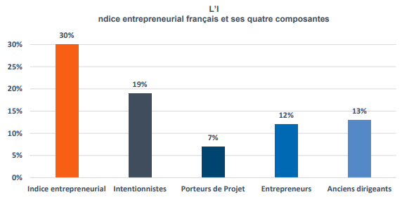
What is Entrepreneurship ?
A process by which individuals, teams or organisations identify and exploit (business) opportunities for new products or services that satisfy a need in the market.
New ventures (start-ups)
Social entrepreneurship
Corporate venturing & intrapreneurship
Spin-offs (extrapreneurship) / Spin-ins
Franchises

Slide 46
Attention
Is it a BUSINESS opportunity ?
Can you create a viable business doing this ? Is it a BUSINESS opportunity ?
Customers would like a full service airline at a low-cost airline price

Slide 47
The ‘traditional’ way
Entrepreneurial Intent
Opportunity Search & Discovery
Opportunity Recognition
Opportunity Assessment & Feasibility Analysis
Decision to Seize opportunity
Business Planning
Analysis of Industry and Competitive Environment
NOT a « neat » process
- Effectuation – « what works »
- Lean Startup
Business Model and Strategy
Financing & Funding

Slide 48
The ‘traditional’ way
Entrepreneurial Intent
Opportunity Search & Discovery
Opportunity Recognition

Slide 49
Opportunity Recognition
Alertness
Uncertainty
Risk Taking Propensity
Nach (Need for Achievement)
Locus of control
Self efficacy
Team leadership
Recognizing an opportunity, circumstances under which products and services can satisfy a need in the market or environment
See the opportunity
Combine resources and capabilities to seize opportunity
Entrepreneur or Team (Skill and Will)
Trends & Gaps
Resouces & Capabilities
PESTEL awareness
Trends and Uncertainties
Gaps identification
Blue ocean opportunities
Scenarios
Sufficient resources
Access to resources
Resource allocation systems (intrapreneurs)

Slide 50

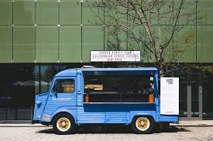
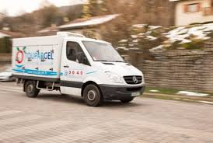


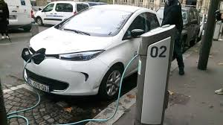

See opportunities or create them ?
Charge anywhere
Adverse effects !

Slide 51
A balance of both
Level of Competition
Information Sharing
Source recognition
ALGORITHMIC patterns, formulae, experience, problem solving, connect the dots UNCERTAINTY reduced with new info
HEURISTIC sensemaking, discussion, interpretation, trail and error AMBIGUITY
Strong signals
Weak signals
Archived info
Tacit info
Cognitivist approach
Constructivist approach
Boundary spanning activities
Culture of trust
Org Structure
Availability of Rich Information
Vaghely & Julien, JBV 25 (2010)

Slide 52
Entrepreneurial Experience
Business ownership experience and opportunity identification
Why does it increase and then decrease ?
Number of business opportunities identified
0 1 2 3 4 5 6 7 8
Total number of business established and/or purchased to date
The Extent and Nature of Opportunity Identification by Experienced Entrepreneurs, Ucbasaran, Westhead & Wright, 2009

Slide 53
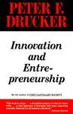

Typical sources of opportunity
Drucker
1
The unexpected
Require a focused analysis. Symptoms of change underway
2
The incongruity (persistent discrepancies)
3
Process needs (well defined)
4
Structural changes
5
Demographics
A broad vision is required External
6
Changes in perception, mood and meaning
7
New knowledge

Slide 54
The process
Entrepreneurial Intent
Now ..evaluate !
Opportuity Search & Discovery
Opportunity Recognition
Opportunity Assessment & Feasibility Analysis
Decision to Seize opportunity
Business Planning
Analysis of Industry and Competitive Environment
Business Model and Strategy
Financing & Funding

Slide 55
Evaluation
Strategic fit? Career fit?
Does the market exist? Is it growing? Do first customers exist?
What is potential competition? Response?
Financially viable?
Tech feasibility and tech uncertainty (is tech stable?)
Do we have knowledge, people, abilities ?

Slide 56
Entrepreneurship
Key factors
Entrepreneurs and innovators – it starts with people !
Access to an adequate amount of resources (not too much)
Support networks – the « extended » team
The « A » team with a « B » project is better than The « B » team with the « A » project

Slide 57
Evaluation (by VC)
Capacity to sustain effort over a long period of time 64%
Intimate understanding of market 62%
Return > 10x in 5 to 10 years 50%
Capacity to lead based on experience 50%
Capacity to evaluate and react to risks 48%
Possibility to « get out » 44%
Significant market growth 43%
In US : 10-100 M$
In US : 30-60% growth per year in market (venture earned about 20% per year)
Experience coherent with project 37%
Clear project vision is expressed 31%

Slide 58
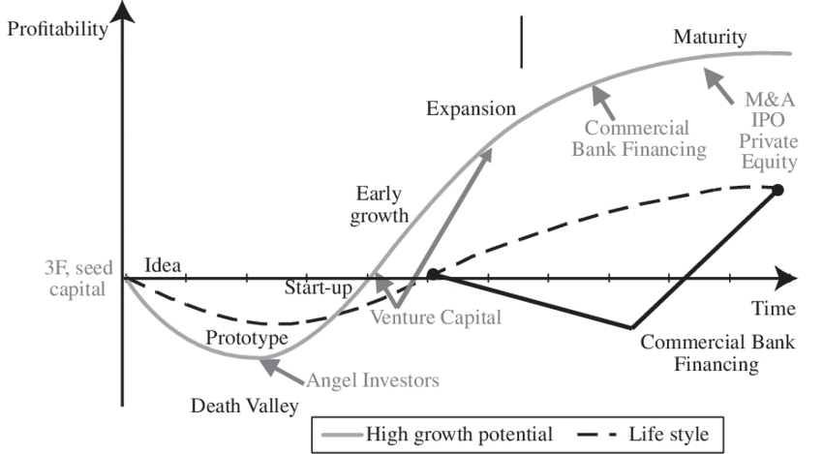
Life-cycle
Startup: Capital is King ! Loans, credit cards, Govt. Funding, early stage VC
Financing & funding & evolution
Growth: New role as manager Tough to transition
Maturity: Keep energy/creativity
Intrapreneurship strategies
2nd generation products
Exit: Founder leaves Investors leave IPO, trade sale
Next? (serial entrepreneur)

Slide 59
Effectuation
Start with simple idea (sometimes no idea) – with what you have (personality, knowledge, relations)
Use existing resources or resources easy-to-acquire (credit card, relations)
No business plan – « build as you go »
Use surprises (errors) to do better (make lemonade from lemons)
No market study – launch with « acceptable losses » – focus is not on what you can earn – but rather on « what you are ready to lose »
Control your future vs predict it

Slide 60
Not linear
Minimum Viable Product (MVP)
Build
Lean Startup
Short product development cycles
Testing of business model
Testing hypotheses with a MVP
Pivoting based on results
Ideas
Test Hyp. thanks to MVP
Persevere
Learn
Pivot to a new approach
Actionable Metrics linked to business model for decisions

Slide 61


Social entrepreneurship
Addresses social problems through entrepreneurship
Toilets (Jack Sim) (WTO – World Toilet Org.)
Cabbages & Condoms (Bangkok)
Social mission
Cooperative form is common
Market based revenues are typically on a not-for-profit basis
Margin pushed into social objective
BOP (Base of Pyramid)
Microfunding/crowd

Slide 62
Innovation dilemmas

Slide 63
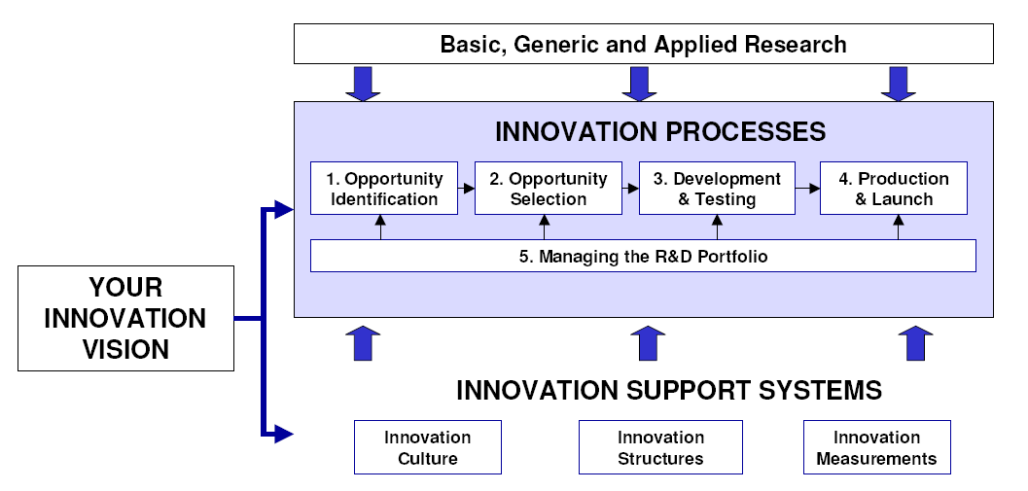
Innovation
Innovation is not the same as invention
Can you innovate without inventing ? YES
Are all innovations inventions ? NO (improvements, incremental,..)
Conversion of new knowledge into a new product, process or service AND putting of this new product,process or service into actual commercial use.

Slide 64
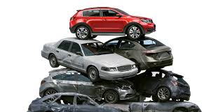
3 challenges/dilemmas
Follow technological opportunity even against market demand (future vs current customers is often considered here too) Radical or Incremental innovation
Invest in product or process innovation (make something new or make in a new way)
Keep quiet (closed innovation) or open up (open innovation or closed?)

Slide 65
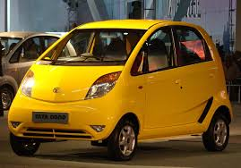
1. Tech push or market pull ?
Tech push : innovation driven/pushed by new technologies
R&D driven perspective (offer / supply perspective)
Often radical/disruptive
Market pull : looks at use by customers
Customer driven innovation
« Pain points » Lead users : helps identify needs (need to be in contact with them) (ex. LEGO lead user groups; Volvo trucks, Playmobile,…) Frugal Innovation : ordinary customers with little resources - Tata automobiles Nano
Radical vs Incremental Innovation

Slide 66
2. Product or Process ?
Product – features of product/service sold
Apple is good here
Typically in first stages of an industry as technologies compete for acceptance - Tech norms (VHS/Beta; Blueray; E-vehicle recharging;
A dominant design emerges over time
Process – how product is produced and distributed
Dell computers (differentiation of computer, direct sales, modularity, build to order)
Usually after the dominant design has emerged - ex. Ford’s assembly line
All restarts after time with more product innovation as the dominant design is put into question!

Slide 67
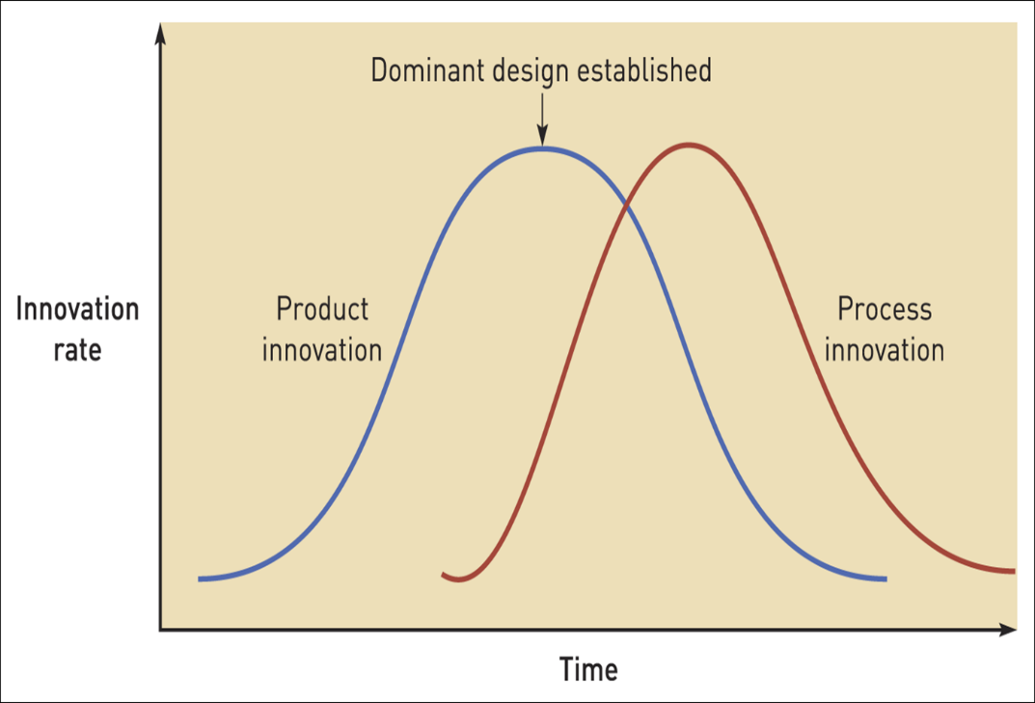
2. Product or Process ?
New developing industries favour product innovations.
Maturing industries favour process innovations.
Small new entrants have greatest opportunities in the early stages of an industry.
Large incumbent firms have advantages in later stages.

Slide 68
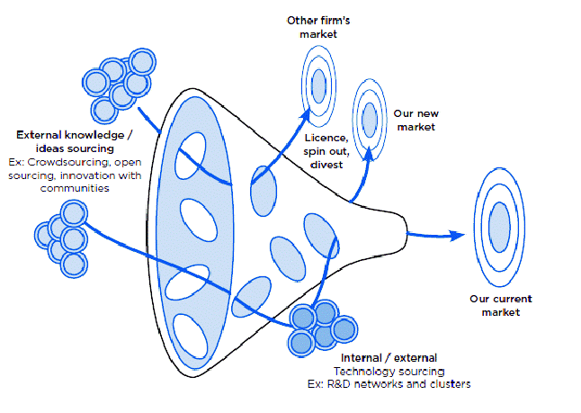
3. Open or Closed innovation ?
Invention is not innovation
Import and export of knowledge in order to accelerate and enhance innovation
Use external links and network
Ex. P&G Pringles
Ex. Work with universities

Slide 69

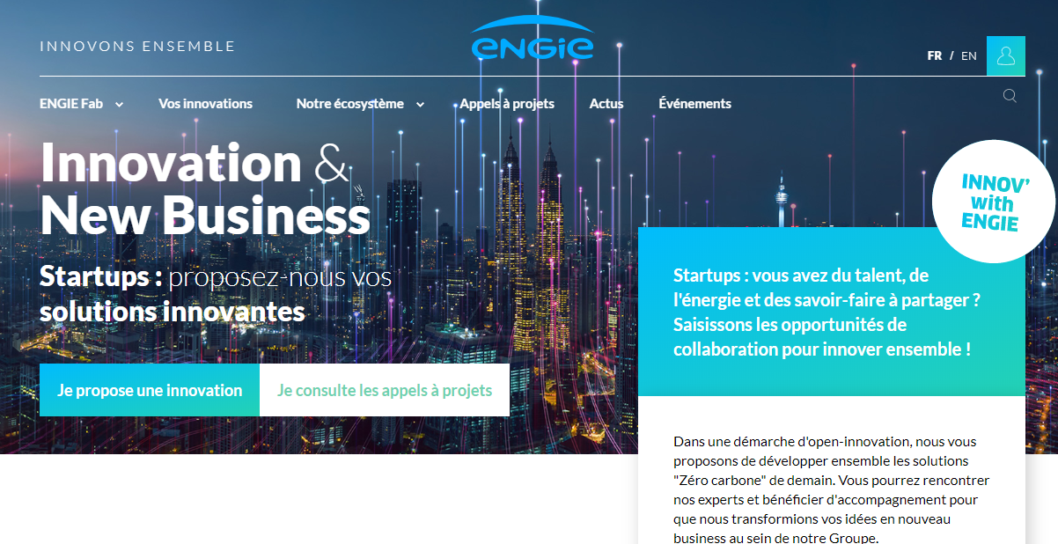

Slide 70
3. Open or closed ?
Competitive rivalry (intense? – favor closed)
One-shot innovations – closed (there are winners)
Continuous innovations – open
Complex technologies – need to fit existing links – hard to open up

Slide 71
Innovators and imitators

Slide 72
First mover
A first mover advantage exists where an organisation is better off than its competitors as a result of being first to market with a new product, service or process.
What are potential benefits for cost and differentiation strategies?
Experience curve → cost advantage
Scale benefits → cost advantage
Pre-emption of scarce resources → cost advantage
Reputation (ex. Established in 1900)
Buyer switching costs (establish the standard)
Makes a price war easier with new entrants / followers
Marketing advantage allowing for higher prices

Slide 73
Can following be better ?
Free ride on innovation investments of first-movers
Imitate (35% less expensive to do this!)
Learning (let the first mover make mistakes – and then YOU learn from them)
What works !
Radical innovation → may be better to be a « fast second »
Dominate 2nd generation of the technology (maybe not 2nd into the market) ex. the « improved » version

Slide 74
3 factors to decide
Imitate or innovate
Can you capture the value of innovation ?
Property rights ?
Easy to copy/imitate ?
Existence of complementary assets
Do you have the requisite assets to scale up ?
Do you have what it takes to grow the business to reap benefits of innovation?
Slow or fast moving context (ex. do tastes change quickly)
If things quickly change, little chance of getting back your « investment », little durable advantage to move first

Slide 75
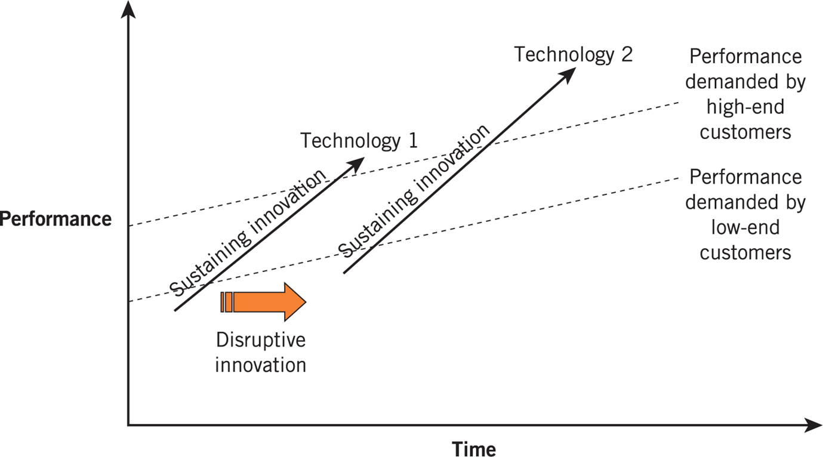
Challenges for incumbents
People attached to existing skills, assets and way of doing business (similar to strategic drift)
Incumbents have TIGHT relations with their existing client base that typically prefer incremental innovations (existing technology)
Are we ready to give up our current customers for potential new customers in the future ?
Radical innovations offer new technologies that offer high potential (even if low potential at first)

Slide 76
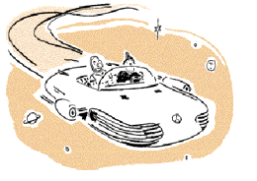
Incumbent plays
Real options
Corporate venturing (ex. new venture units/ black ops)
Radical vs time to market innovations
Industrial Light and Magic (Lucas Film)
Engie New Ventures
Intrapreneurship
Existing managers to use time/resources for ideas

Slide 77
Questions ?
:

Slide 78
Strategy
Corporate Strategy Diversification Alliances
PART 1

Slide 79
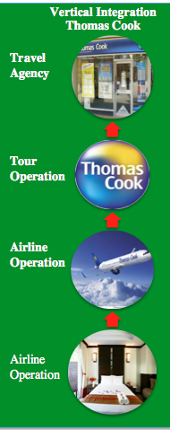
Thomas Cook
Large diversified vertically-integrated company
What happened?
Large number of phyical agencies via acquistions creating large fixed costs – big volume is needed
Not ready for low cost competition and online sales
Merged with failing MyTravel to expand operations even more !
Huge C-suite pay and bonuses
Was Thomas Cook too diversified?
Was Thomas Cook too big ?

Slide 80
Strategic Choices
Business strategy
Sessions 7-10
Strategic choices involve understanding the underlying bases for future strategy at both the business unit and corporate levels and the options for developing strategy in terms of both the directions and methods of development.
What business to include in portfolio?
How do our businesses compete?
How should we compete internationally?
Are we innovating effectively?
Is non-organic growth important?
Corporate Strategy
International
Strategic Choices
Entre-preneurship
Acquisitions & Alliances

Slide 81
Strategic Choices
Business strategy
Sessions 7-10
Strategic choices involve understanding the underlying bases for future strategy at both the business unit and corporate levels and the options for developing strategy in terms of both the directions and methods of development.
What business to include in portfolio?
How do our businesses compete?
How should we compete internationally?
Are we innovating effectively?
Is non-organic growth important?
Corporate Strategy
International
Strategic Choices
Entre-preneurship
Acquisitions & Alliances

Slide 82
Topics
Growth strategies
Diversification
Vertical Integration
Corporate Parenting
Portfolio Management
Strategic Alliances

Slide 83
Introduction

Slide 84
Corporate Strategy
Fresh Dairy (52%)
Water (20%)
Medical Nutrition (7%)
Baby (21%)
As skills/resources develop and opportunities emerge, companies may seek to enter (or leave) business activities
How broad should the scope be? How to enter new domain ?
What potential benefits and costs are there?

Slide 85
Critical questions
What business do we want to be in? (What directions can we take?)
What markets do we want to be in?
What products/services do we want to sell?
Why should we diversify our activity? (What drives us to diversify?)
Should we integrate activities that are above (upstream) or below us (downstream)?
What benefits can the « head office » bring to these activities (so called « parenting advantage »
What does a high performing portfolio of activities look like ?

Slide 86
Strategy directions
In which directions can I diversify?

Slide 87
In which areas could we grow ?
Ansoff’s product/market growth matrix – directions to investigate
Products/Services
Consolidation Strategy to increase depth in existing market
Existing
New
A
B
Existing
Penetrate/ Consolidate
New Products Same Market
Markets
Related diversification
Diversifiction Strategies to increase product range or markets served by the company
C
D
New
Same Products New Market
Conglomerate Diversification (unrelated)

Slide 88
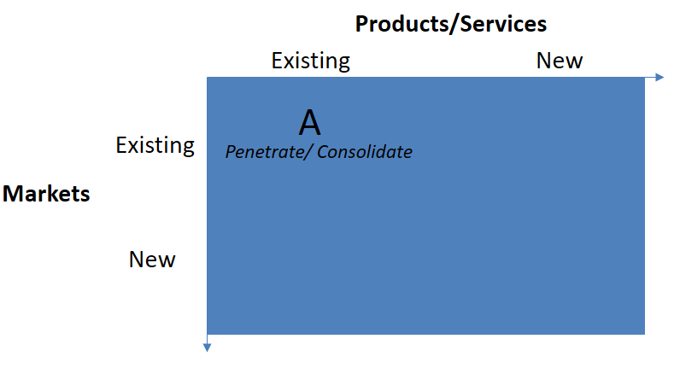
Market Penetration
Increase share of current markets with current product range
Competitor (rivals) response to be considered (especially in slow growing, flat or declining markets)
In low growth markets - an acquisition of rivals can be considered to reduce rivalry and increase share.
Legal constraints (ex. horizontal merger rules) – concerns of abuse of a dominant position

Slide 89
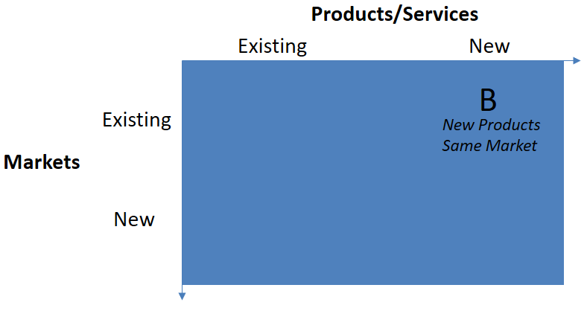
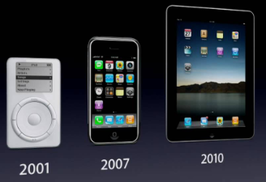
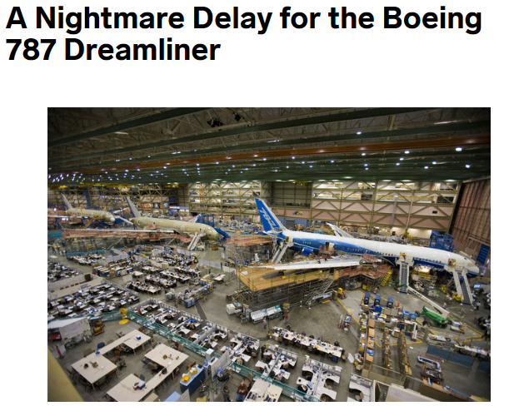
New Product Development
Deliver modified or new products to existing markets (ex. iPod, iPhone, iPad are very related products in terms of production, components, skills required to build,etc.)
New processes/skills may need to be mastered. (ex. digital transformation of companies to profit from new « digitalized » product range)
Potential investments to be made – and these may be risky
Project risks (delays, changing specs, etc.)
Boeing Dreamliner delayed nearly 2 years

Slide 90
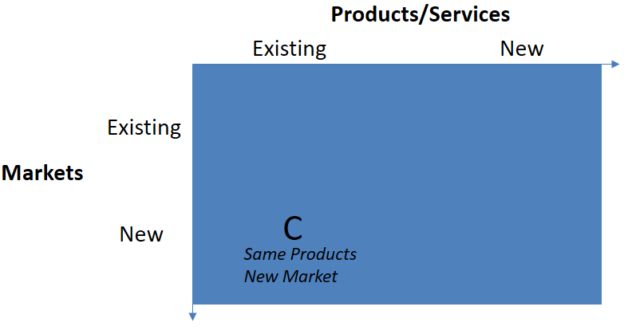

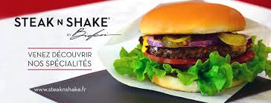
New Market Development
Potentially less expensive, less risky and faster than product development diversification.
New users for the existing product (ex. aluminum to be used in airplanes – was used in cans)
New geographies – internationalisation, expand beyond local market
Some development may be needed (adapt to new market, packaging, ..)
Make sure you meet CSFs of new market (they may be different) and if you have the internal capabilities to succeed (can you effectively market/sell to the new market?)

Slide 91
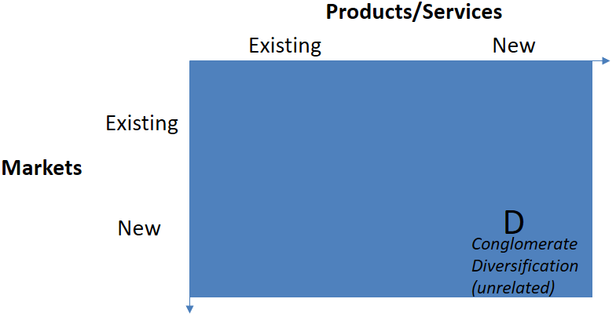


Conglomerate Diversification
Radical change in scope
Potential benefits of each business being part of a « group » of differing activities (synergies, scope economies from producing complementary products)
Large size may have benefits (access to financing,..)
Customer may increase trust or apply brand « value » to new offer (halo effects)
BUT
Customers and others may be skeptical of synergies
Bureaucratic costs can result in “conglomerate discount” of share value (1+1< 2)

Slide 92
Diversification drivers
Why could it be good for companies to diversify?

Slide 93
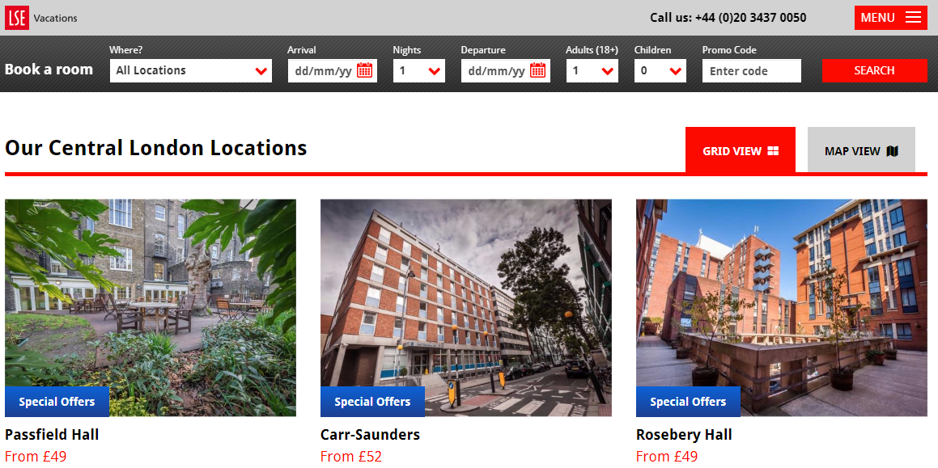

Value creation drivers of diversification
1. Economies of scope (efficiency gains)
Economies of scope refer to efficiency gains made through applying existing organisational resources or competencies to new markets or services.

Slide 94
Do you know what different businesses TESLA is operating?
?

Slide 95
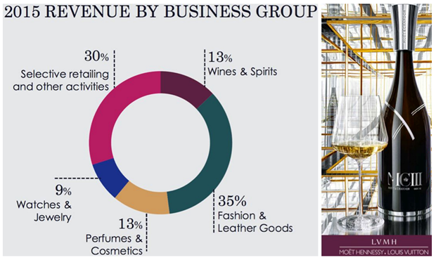
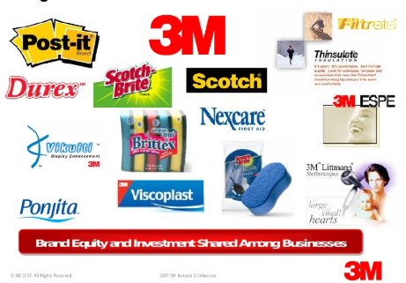
Value creation drivers of diversification
2. Stretching corporate management competencies
Apply strong corporate parenting skills to new activities
The dominant logic is the set of corporate-level managerial competencies applied across the portfolio of businesses
Brand and image development

Slide 96

Value creation drivers of diversification
3. Exploiting superior internal processes
In developing economies, internal processes may be better than those found in the open market (investment management, HR development, use of networks)
Pharma – Financial Services – High Tech – Mining - ….

Slide 97
Value creation drivers of diversification
4. Increasing market power
Match your competitor’s wide product range (discourages aggressive moves by competitors)
Similar competitors will avoid aggressive competition
Ability to cross-subsidize losses in one activity with profits of another
Compete aggressively on one market
This is a threat to entrants for example (cross subsidization may give you « deep pockets » required for a threat to work.

Slide 98
VERTICAL INTEGRATION

Slide 99
Horizontal integration strategies
Potential benefits if components can be sourced in same way or production shares similar processes
Components Manufacturer
Truck Manufacturer
Automobile Manufacturer
Bus Manufacturer
Automobile Concession

Slide 100
Vertical integration strategies
Backward or « upstream » integration
Forward or « downstream » integration
Components Manufacturer
Components Manufacturer
Components Manufacturer
Ex. Starbucks growing it’s own beans
Capture upstream profits
&
Automobile Manufacturer
Automobile Manufacturer
Ex. Airlines selling tickets directly to clients
Capture downstream
profits
Automobile Manufacturer
Value network
&
Automobile Concession
Automobile Concession
Automobile Concession

Slide 101
Problems with integration
Dilution of returns & distinct capabilities
Significant investments may be required and if the profits of the other activity are lower than yours, the average return on investments for shareholders decreases.
Integration may require different distinct resources and capabilities
Some sectors are now dis-integrating! (i.e. companies stop doing some internal activities and have them done by someone else)
Outsourcing (subcontracting previously internal processes)
Ex. Call centers (they can do it better) Ex. Payroll services (specialists, do it better)

Slide 102
Problems with subcontracting
Risk of opportunism
Maybe there are few alternatives – you have low power!
If the service of product they provide to you is complex it might be tough to precisely define in a contract – this lack of clarity creates opportunities for a subcontractor to take advantage of the situation
Specific investments may be needed to make the relationship work (ex. you install software that helps communicate with your supplier). This creates a « switching » cost that can be exploited.

Slide 103

Measure the pros & cons
Integrate
Subcontract
If there is a risk the subcontractor can behave in an opportunistic way.
If unique strategic capabilities you don’t have are required

Slide 104
END PART 1

Slide 105
Strategy
Corporate Strategy Diversification Alliances
PART 2

Slide 106
Topics
Growth strategies
Diversification
Vertical Integration
Corporate Parenting
Portfolio Management
Strategic Alliances

Slide 107
Value of corporate parenting

Slide 108
Is the parent company adding value?
Parent
Show you add value as a parent or expose yourself to having some activities taken over by others.
Are you the BEST possible parent?
Business Activity 1
Business Activity 2

Slide 109

The Value-adding parent
Envisioning Clear vision, inspiration, reason, the sens of the« whole »
Facilitate Synergies Faciltate cooperation through systems, rewards
Learning/Coaching Improve activities. Learn across the organisation. Sharing/
Central Service Capital for investment. Shared common services. Provide opportunites internal transfers
Intervening Challenge the activities. Monitor activities and intervene to fix/reward.

Slide 110

The Value-destroying parent
Adds costs Costly management, C-suite benefits
Bureaucracy Red tape to get things done. Maybe best done locally for quick response.
Opaque performance Weak performance hidden by strong performers.Weak performers can persist
Too much intervention Looking over shoulder. Activities will look too much at their unit performance and less synergies

Slide 111




Three corporate parenting scenarios
The portfolio manager operates as an active investor in a way that shareholders in the stock market are either too dispersed or too inexpert to be able to do
Not very concerned about « relatedness »
Investment focus with clear financial targets
Little direct involvement
The synergy manager is a corporate parent seeking to enhance value for business units by managing synergies across business units
Provide common vision, purpose, facilitating cooperation
Attention to
Management costs
BU self-interest (align rewards)
Illusory synergies
The parental developer seeks to employ its own capabilities/resources to add value to its businesses
Transfer value (specialist skills, brand,…) down to businesses
Provide central services & resources
Attention to
Parental focus (your +)
Divest if not adding value to a « jewel »

Slide 112
Portfolio management matrices

Slide 113
Matrices help us manage the portfolio
Balance – is our portfolio effectively balanced?
Attractiveness – how attractive are the different businesses in the portfolio
Fit – do they make sense together? Are there synergies?
20%
Savings
80%
Corporation 1 Corporation 2

Slide 114
BCG (Boston Consulting Group) matrix
The BCG matrix uses market share and market growth critieria for determining the attractiveness and balance of a business portfolio
Cash cows should not hoard their profits
« Market share » depends on how you define the market.
What about external capital vs from inside?
Motivation for employees of Cows and Dogs my be low. Cows may become Dogs !
Commercial links may require keeping a Dog alive.
High
Market Share
Low
High
Stars
Require heavy investment but they should create benefits to be self sufficient
Question Marks
Making it into a future « star » requires investment. Some fail to become stars – so nurture many!
Market Growth
Cash Cows
Maybe was a past Star. Now market is mature. Low investment needs. High profits.
Dogs
Cash drain. Divest? Close?
Low

Slide 115
GE-McKinsey Matrix
The GE McKinsey matrix helps evaluate the business potential for each component of the portfolio, helping direct investments.
Developed in 1970s for GE.
Companies have a rare amount of money to invest – so where do we put our efforts?
In which SBU should we invest ?
What new SBUs / products are needed in the portfolio ?
What should be divested ?

Slide 116
GE-McKinsey Matrix
Market share
Growth in Market Share
Loyalty
Brand
CSFs
High
Competitive Strength of SBU vis-à-vis rivals
Low
High
HOLD (Invest AFTER investing in GROW areas)
GROW (Priorty areas to invest)
Market Long-term Attractiveness
HARVEST (Invest just enough to keep it operating or get rid of it)
Market size
Exepected growth
Profitability trends
5 Forces trends
Low

Slide 117
GE-McKinsey Matrix
Market share
Growth in Market Share
Loyalty
Brand
CSFs
High
Competitive Strength of SBU vis-à-vis rivals
Low
High
Market Long-term Attractiveness
Market size
Exepected growth
Profitability trends
5 Forces trends
Low

Slide 118
GE-McKinsey Matrix
High
Competitive Strength of SBU vis-à-vis rivals
Low
High
Protect your Position
Invest to Build
Build Selectively
Market Long-term Attractiveness
Build Selectively
Manage for Earnings
Expand or Harvest
Protect and Refocus
Manage for Earnings
Potential for Divestment
Low

Slide 119
QUESTIONS ?

Slide 120
Strategy
M&A and Strategic Alliances

Slide 121
Strategic options & methods
Making the choice
Organic Development
For example: Diversification Internationalisation Innovation
Mergers & Acquisitions
Strategic Alliances

Slide 122


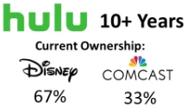


Basics
Merger
Acquisition
Joint Venture Alliance
Non-Equity Alliance

Slide 123
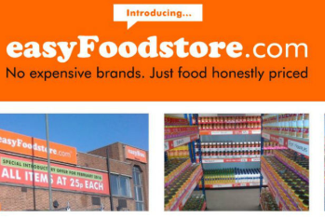
Organic Development
Organic development is where a strategy is pursued by building on and developing an organisation’s own capabilties.
Knowledge and learning
Spreading investment over time
No availability constraints
Strategic independence
Culture management
However, often organisations have to go beyond their own internal capabilities and look externally for methods to pursue their strategies

Slide 124
MERGERS AND ACQUISITIONS

Slide 125


M&A
Types
Acquistion is achieved by purchasing a majority of shares in a target company

Slide 126
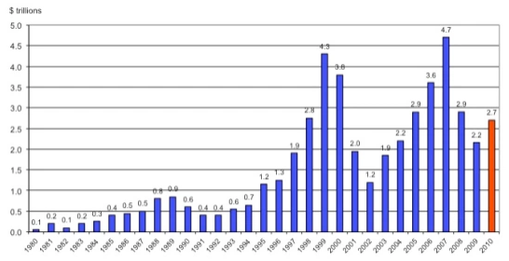
M&A
Types
A merger is the combination of two previously separate organisations in order to form a new company.
Often of similar size (unlike acquisitions)
Expectations of broadly equal status post merger
M&A Cycles exist – be careful to not overbid or overvalue a company during M&A hype cycles

Slide 127
M&A
Strategic Motives
Strategic
Extend reach
Consolidation
Capabilities
Financial
Financial efficiency
Tax efficiency
Asset stripping or unbundling
Managerial
Personal ambition
Bandwagon effects
There are many good (and bad reasons).
The general consensus remains that the average performance of deals is unimpressive, with some evidence suggesting that over half fail !

Slide 128
M&A
Completion and change of ownership
Due diligence
The M&A Process
Target Choice
Negotiations
Integration
Results

Slide 129
M&A
Completion and change of ownership
Due diligence
The M&A Process
Target Choice
Negotiations
Integration
Results
Strategic fit refers to the extent to which the target firm strengthens or complements the acquiring firm’s strategy
Does the M&A target meet the strategic objective for undertaking an M&A
Don’t overestimate positive synergies & don’t underestimate sources of negative synergies (changing business models for example)
Organisation fit refers to the match between management practices, cultural practices and staff characteristics between the target and acquiring firm.
Large differences (culture, language, other) can create integration problems!

Slide 130
M&A
Completion and change of ownership
Due diligence
The M&A Process
Target Choice
Negotiations
Integration
Results
Negotiation is critical and can break a deal
The « price » of acquistion is determined through one of many valuation techniques (payback period, discounted cash flow, etc.)
The price is often increased to include a premium for control
Be careful of overpaying and then cutting back on critical investments that might be essential for success.

Slide 131
M&A
Completion and change of ownership
Due diligence
The M&A Process
Target Choice
Negotiations
Integration
Results
Value extraction depends on integration.
Integration is often challenging because of problems with organisational fit.
Poor integration can cause M&A to fail.
2 key criteria :
Strategic interdependence : shared resources and capabilities
Organisation autonomy : to benefit from a distinct culture of the acquired firm (for example)

Slide 132
M&A
Integration strategies for post-acquistion management
Low
High
Acquired firm’s need for autonomy
Low
Intensive Care
Little to be gained
Avoid contamination from integration
Impose strict turn-around targets
Preservation
Acquired firm well run but is not very compatible with the acquirer (typical of conglomerate deals)
Minimum changes requested
Knowledge transfer
Absorption
Strategic interdependence is necessary
Adapt structure to the needs of new owners
Change acquired firm’s culture
Symbiosis
For example in professional services organsations – high creativity
Learn the best from each other
Retain incumbent management at start
High

Slide 133
Strategic alliances

Slide 134
Strategic Alliances
A strategic alliance is where two or more organizations share resources and activities to pursue a common strategy.
The average large corporation is simultaneously managing 30 alliances at a given time.
Companies need to focus on « collective success »
Alliances sometimes compete against each other (ex. airline alliances) and winning relies on creating « collaborative advantage »
Computer game companies rely on alliances with game developers and so they must maintain and manage this network

Slide 135
Strategic Alliances
Motives
A
Scale alliances – lower costs, more bargaining power and sharing risks
Access alliances – partners provide needed capabilities (e.g. distribution outlets or licenses to brands)
Complementary alliances – bringing together complementary strengths to offset the other partner’s weaknesses
Collusive alliances – to increase market power. Might be kept secret to evade competition regulations.
inputs
outputs
B
outputs
A
B
A
outputs
B
A
inputs
outputs
B

Slide 136
Making the Choice

Slide 137
Buy, ally or DIY ?
Factors to consider
Buy
Ally
DIY
Urgency – organic development is slowest, alliances accelerate the process but acquisitions are quickest.
Uncertainty – an alliance means risks and costs are shared and thus a failure means these costs are shared.
Soft capabilities – acquisitions work best with ‘hard’ resources (e.g. production units) rather than ‘soft’ resources (e.g. people). Culture clash is the big issue.
Modularity of capabilities – if the needed capabilities can be clearly separated from the rest of the organisation an alliance may be best.
Fast
Fast
Slow
Failures potentally can be sold
Share losses and retain buy option
Failures likely can’t be sold
Culture and harder-to-value soft resources
Culture and control problems
Cultural consistency
Avoid buying whole company
Ally just with relevant partner
Develop in new venture unit

Slide 138
QUESTIONS ?

Slide 139
Strategy
Internationalisation

Slide 140
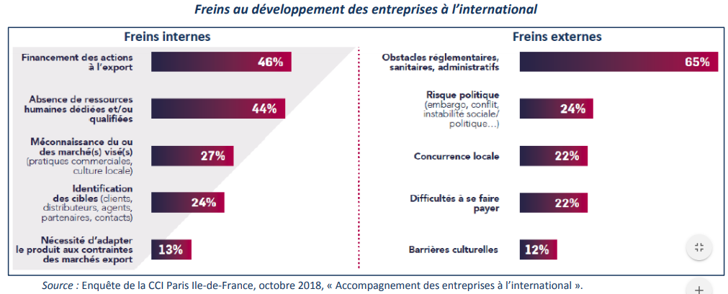
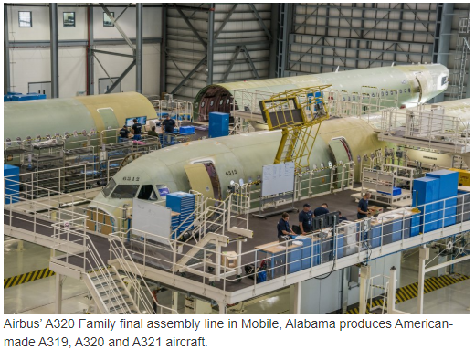
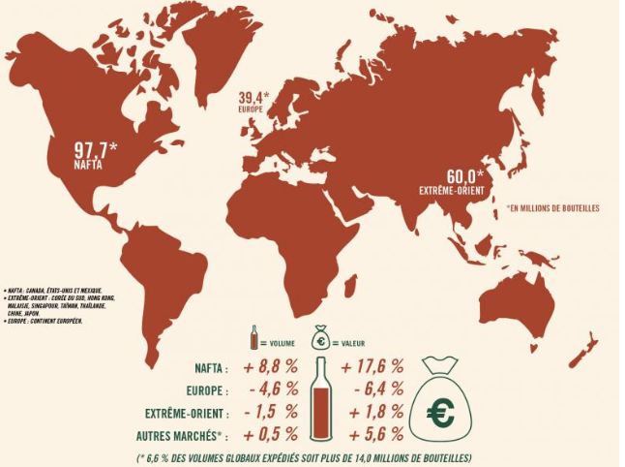
Internationalisation
Airbus opened its first commercial aircraft production site in the United States in 2015, a 53-acre site that produces up to 60 A320 Family aircraft per year. Tariffs aren’t being applied to components shipped for assembly to Alabama.
98% of the production of Cognac is exported, principally towards North America (46% of volume) and Asia (28%)
Only about 4% of companies export their goods and services in France including about 125 000 SMEs, less than Italy (200 000) and Germany (300 000)

Slide 141
Strategic Choices
Business strategy
Sessions 7-10
Strategic choices involve understanding the underlying bases for future strategy at both the business unit and corporate levels and the options for developing strategy in terms of both the directions and methods of development.
What business to include in portfolio?
How do our businesses compete?
How should we compete internationally?
Are we innovating effectively?
Is non-organic growth important?
Corporate Strategy
International
Strategic Choices
Entre-preneurship
Acquisitions & Alliances

Slide 142
Strategic Choices
Business strategy
Sessions 7-10
Strategic choices involve understanding the underlying bases for future strategy at both the business unit and corporate levels and the options for developing strategy in terms of both the directions and methods of development.
What business to include in portfolio?
How do our businesses compete?
How should we compete internationally?
Are we innovating effectively?
Is non-organic growth important?
Corporate Strategy
International
Strategic Choices
Entre-preneurship
Acquisitions & Alliances

Slide 143
Topics
Internationalisation drivers
Sources of Advantage - Firm-Specific - Geographic
International Strategy
Market Selection
Mode of Entry

Slide 144
IntERNATIONALISATION DRIVERS

Slide 145

Internationalisation Drivers
Internationalisation drivers
Sources of Advantage - Firm-Specific - Geographic
International Strategy
Opportunities and Challenges
+ lower trade barriers + increased investment opportunities + migration and population mobility + communication technologies + legal clarity + powerful economic zones (BRICs, ..)
Market Selection
Mode of Entry
- Barriers still exist ( « infant » industries, strategic industries) - Heterogeneous needs and wants in some markets
- Heterogoneous product constraints - « one big market » hype

Slide 146
Internationalisation Drivers
Internationalisation drivers
Sources of Advantage - Firm-Specific - Geographic
International Strategy
George Yip’s Globalisation Framework
International strategy potential is determined by market drivers, cost drivers, government drivers and competitive drivers
Market Selection
Mode of Entry
Market Drivers
Cost Drivers
Government Drivers
Competitive Drivers

Slide 147


Internationalisation Drivers
Internationalisation drivers
Sources of Advantage - Firm-Specific - Geographic
International Strategy
George Yip’s Globalisation Framework
International strategy potential is determined by market drivers, cost drivers, government drivers and competitive drivers
Market Selection
Mode of Entry
Market Drivers
Standardisation of market characteristics
Similar customer needs and tastes (need for a credit card)
Presence of global customers (like Valeo’s customers)
Transferable marketing
Cost Drivers
Government Drivers
Competitive Drivers

Slide 148



Internationalisation Drivers
Internationalisation drivers
Sources of Advantage - Firm-Specific - Geographic
International Strategy
George Yip’s Globalisation Framework
International strategy potential is determined by market drivers, cost drivers, government drivers and competitive drivers
Market Selection
Mode of Entry
Market Drivers
Cost reduction through operating internationally
Increased volume to create scale economies (production, purchasing)
Country specific differences (cheap labor, unique resources)
Favourable logistics costs relative to final value
Cost Drivers
Government Drivers
Competitive Drivers

Slide 149


Internationalisation Drivers
Internationalisation drivers
Sources of Advantage - Firm-Specific - Geographic
International Strategy
George Yip’s Globalisation Framework
International strategy potential is determined by market drivers, cost drivers, government drivers and competitive drivers
Market Selection
Mode of Entry
Market Drivers
Reduction of barriers to trade and investment (FDI)
Lower tariff & non-tariff barriers
Favourable trading zones (EU, NAFTA,.)
Adoption of free-markets (Heritage Foundation’s index of economic trade freedom)
Technology standardisation
Cost Drivers
2000
Government Drivers
Competitive Drivers
2020

Slide 150

Internationalisation Drivers
Internationalisation drivers
Sources of Advantage - Firm-Specific - Geographic
International Strategy
George Yip’s Globalisation Framework
International strategy potential is determined by market drivers, cost drivers, government drivers and competitive drivers
Market Selection
Mode of Entry
Market Drivers
Globalisation as an integrated worldwide strategy (coordination of geographically dispersed activities)
Interdependence across company’s value chain activities (global Value Chain) (ex. Ferrero)
Global competitors able to cross-subsidize operations – to compete you’ll have to probably do the same.
Cost Drivers
Government Drivers
Competitive Drivers

Slide 151
Sources of Advantage

Slide 152
Sources of advantage
Internationalisation drivers
Sources of Advantage - Firm-Specific - Geographic
International Strategy
Firm specific and geographic
Firm level factors
Do you have the knowledge?
Do you have the culture?
Do you have VRIO resources to compete abroad?
Market Selection
Mode of Entry
Geographic or country specific factors
How does a particular location give an advantage (locational advantage)
How can sourcing overseas provide an advantage through an international value system

Slide 153
Internationalisation Drivers
Internationalisation drivers
Sources of Advantage - Firm-Specific - Geographic
International Strategy
Porter’s Diamond Model of National Advantage
Porter’s diamond model suggests that locational advantages may stem from local factor conditions; local demand conditions; local related and supporting industries; and from local firm strategy, industry structure and rivalry.
Market Selection
Mode of Entry
Factor Conditions
What home-based locational advantages do you have that can be exploited internationally ?
Strategy Structure Rivalry
Demand Conditions
Related & Supporting Industries

Slide 154
Internationalisation Drivers
Internationalisation drivers
Sources of Advantage - Firm-Specific - Geographic
International Strategy
Porter’s Diamond Model of National Advantage
Porter’s diamond model suggests that locational advantages may stem from local factor conditions; local demand conditions; local related and supporting industries; and from local firm strategy, industry structure and rivalry.
Market Selection
Mode of Entry
Factors of production that translate into advantages for nationally based firms
Cheap energy in North America
Language skills in Switzerland for banking
Mountain plantations for coffee
Factor Conditions
Strategy Structure Rivalry
Demand Conditions
Related & Supporting Industries

Slide 155


Internationalisation Drivers
Internationalisation drivers
Sources of Advantage - Firm-Specific - Geographic
International Strategy
Porter’s Diamond Model of National Advantage
Porter’s diamond model suggests that locational advantages may stem from local factor conditions; local demand conditions; local related and supporting industries; and from local firm strategy, industry structure and rivalry.
Market Selection
Mode of Entry
Demanding domestic customers that prepare nationally based companies for international competition
Sophisticated fashion customers in Paris
Need for rugged outerwear in Canada
Service quality in Singapore
Factor Conditions
Strategy Structure Rivalry
Demand Conditions
Related & Supporting Industries

Slide 156


Internationalisation Drivers
Internationalisation drivers
Sources of Advantage - Firm-Specific - Geographic
International Strategy
Porter’s Diamond Model of National Advantage
Porter’s diamond model suggests that locational advantages may stem from local factor conditions; local demand conditions; local related and supporting industries; and from local firm strategy, industry structure and rivalry.
Market Selection
Mode of Entry
Local ‘clusters’ of related and mutually supporting industries (ecosystems)
Leather industry in northern Italy
High tech and software in Silicon valley
Factor Conditions
Strategy Structure Rivalry
Demand Conditions
Related & Supporting Industries

Slide 157


Internationalisation Drivers
Internationalisation drivers
Sources of Advantage - Firm-Specific - Geographic
International Strategy
Porter’s Diamond Model of National Advantage
Porter’s diamond model suggests that locational advantages may stem from local factor conditions; local demand conditions; local related and supporting industries; and from local firm strategy, industry structure and rivalry.
Market Selection
Mode of Entry
Characteristic strategies, industry structure and rivalry
German companies invest in technical excellence
High level of competition locally (many car companies in Japan)
Factor Conditions
Strategy Structure Rivalry
Demand Conditions
Related & Supporting Industries

Slide 158
Internationalisation Drivers
Internationalisation drivers
Sources of Advantage - Firm-Specific - Geographic
International Strategy
Locational advantages across the value system
What advantages can you obtain from an international value system where activities are placed where they create the most value?
Goal : exploit different skills, resources and cost advantages
Market Selection
Mode of Entry
Global sourcing : purchasing services and components from the most appropriate suppliers around the word.

Slide 159

Internationalisation Drivers
Internationalisation drivers
Sources of Advantage - Firm-Specific - Geographic
International Strategy
Locational advantages across the value system
Market Selection
Cost advantages in specific countries - ex. low wages in specific countries
Unique local capabilities - ex. centres of excellence where capabilities exist (Pharma labs in Boston)
National market characteristics - ex. High-end models made on one country, low-end in another
Mode of Entry

Slide 160
International strategies

Slide 161





International Strategies
Internationalisation drivers
Sources of Advantage - Firm-Specific - Geographic
International Strategy
What kind of international strategy to pursue ?
A careful balancing act to solve
Market Selection
Mode of Entry
Gobal integration of coordinated activities for operational efficiency
Local responsiveness to local (country / regional) differences and market realities
Global-Local Dilemma : the extent to which products and services may be standardized across national boundaries or need to be adapted to meet requirements of specific national markets

Slide 162


International Strategies
Internationalisation drivers
Sources of Advantage - Firm-Specific - Geographic
International Strategy
Four international strategies
Market Selection
Leverage home country advantages abroad
Good if you have a strong reputation, recognized brand and distinct capabilities RISK : local competition better responding to local needs
Mode of Entry
Strong
Pressure for global integration
Export Strategy
Weak
Weak
Pressure for local responsiveness
Strong

Slide 163


International Strategies
Internationalisation drivers
Sources of Advantage - Firm-Specific - Geographic
International Strategy
Four international strategies
Market Selection
Maximize local responsiveness
Different offerings and production in each country
High degree of autonomy in very independent country-based unit
Strong in marketing driven companies RISK : dilution of brand & reputation; inefficiecncies
Mode of Entry
Strong
Pressure for global integration
Export Strategy
Multi-domestic Strategy
Weak
Weak
Pressure for local responsiveness
Strong

Slide 164

International Strategies
Internationalisation drivers
Sources of Advantage - Firm-Specific - Geographic
International Strategy
Four international strategies
Market Selection
Maximize global integration
World = 1 marketplace
Standardisation to capture scale economies
Capture location economies worldwide (dispersed value chain)
Typical for commodity products RISK : reduced flexibility from standardisation
Mode of Entry
Strong
Global Strategy
Pressure for global integration
Export Strategy
Multi-domestic Strategy
Weak
Weak
Pressure for local responsiveness
Strong

Slide 165

International Strategies
Internationalisation drivers
Sources of Advantage - Firm-Specific - Geographic
International Strategy
Four international strategies
Market Selection
Very complex
Efficient and Effective !
Respond to both pressures
Products and operations adapted to local conditions
Leverage learning and innovation across the organisation RISK : very difficult to implement
Mode of Entry
Strong
Global Strategy
Transnational Strategy
Pressure for global integration
Export Strategy
Multi-domestic Strategy
Weak
Weak
Pressure for local responsiveness
Strong

Slide 166
MARKET SELECTIOn

Slide 167

Market selection
Internationalisation drivers
Sources of Advantage - Firm-Specific - Geographic
International Strategy
Which country or countries to enter?
PESTEL analysis
Specific intrinsic characteristics
Politics & Regulations political risk (seizure) & benefits (tax preferred)
Economic GDP growth, investment market, currency risk
Social Education levels, cultural variations/tastes/values
Legal Contract enforcement, labor laws,
Careful of institutional voids
Consider 5-Forces and also reaction of defenders
Consider relative « fit » to your country (« proximity »)
Market Selection
Mode of Entry
Compagnie Française d'Assurance pour le Commerce Extérieur

Slide 168
Market selection
Internationalisation drivers
Sources of Advantage - Firm-Specific - Geographic
International Strategy
Measuring « match » or « fit » with the CAGE framework
Market Selection
Cultural Distance
Cultural norms
Values & Beliefs
Languages
Religions
Management styles and approaches
Attitudes towards internationalisation
Administrative & Political Distance
Administrative systems
Legal traditions
Colonial ties
Corruption (?)
Political hostilities
Shared currency
Mode of Entry
Geographic Distance
Physical distance
Geographical characteristics
Physical size of the country
Hostile neighbors or allies?
Access to trade routes and infrastructure
Economic Distance
Cost of Labor
Level of consumer wealth
Poverty levels

Slide 169


Market selection
Internationalisation drivers
Sources of Advantage - Firm-Specific - Geographic
International Strategy
Measuring « match » or « fit » with the CAGE framework
Market Selection
Mode of Entry
https://www.hofstede-insights.com/country-comparison/

Slide 170
Market entry

Slide 171
Mode of entry
Internationalisation drivers
Sources of Advantage - Firm-Specific - Geographic
International Strategy
How to enter the market
Resource commitment
Level of operational involvement
Control of technology and quality
Control of marketing and sales
Risk
Entry speed
Market Selection
Mode of Entry
Contractual agreement to exploit a product technology or service concept for a fee
100% control (new or acquired firm) (greenfield)
Export
Licensing or Franchising
Joint Ventures
Wholly owned subsidiaries (FDI)
Jointly owned companies where assets, equity and risks are shared by international and local partners

Slide 172
Mode of entry
Internationalisation drivers
Sources of Advantage - Firm-Specific - Geographic
International Strategy
How to enter the market
Resource commitment
Level of operational involvement
Control of technology and quality
Control of marketing and sales
Risk
Entry speed
Market Selection
Mode of Entry
Export
Licensing or Franchising
Joint Ventures
Wholly owned subsidiaries (FDI)
Staged expansion model : companies gradually increase commitment to newly entered markets as they build knowledge and capabilities

Slide 173
Mode of entry
Internationalisation drivers
Sources of Advantage - Firm-Specific - Geographic
International Strategy
Entry mode strategies
 | Export | Licensing or Franchising | Joint Ventures | Wholly owned subsidiaries
Resource commitments
Tech and Quality Control
Marketing & Sales Control
Risk
Entry Speed
Market Selection
Low
Mode of Entry
High
Low/Medium
Low
Fast
+
-
No operational facilities needed in host country
Economies of scale
Internet technologies offer low cost access to markets
No benefit from location (maybe lower costs locally?)
Dependence on intermediairies
Transportation costs
Slow reaction time to changes in demand

Slide 174
Mode of entry
Internationalisation drivers
Sources of Advantage - Firm-Specific - Geographic
International Strategy
Entry mode strategies
 | Export | Licensing or Franchising | Joint Ventures | Wholly owned subsidiaries
Resource commitments
Tech and Quality Control
Marketing & Sales Control
Risk
Entry Speed
Market Selection
Low
Low
Mode of Entry
High
Low/Medium
Low/Medium
Low/Medium
Low
Low
Fast
Fast
+
-
Contractually agreed income through product sales & marketing rights
Limits economic and financial exposure
Hard to find partner and agree on contractual terms
Imitation is possible
Limits benefits from locational advanatages of host nation

Slide 175
Mode of entry
Internationalisation drivers
Sources of Advantage - Firm-Specific - Geographic
International Strategy
Entry mode strategies
 | Export | Licensing or Franchising | Joint Ventures | Wholly owned subsidiaries
Resource commitments
Tech and Quality Control
Marketing & Sales Control
Risk
Entry Speed
Market Selection
Low
Low
Medium
Mode of Entry
High
Low/Medium
Low/Medium
Low/Medium
Low/Medium
Medium
Low
Low
Medium
Fast
Fast
Medium
+
-
Risk shared with partners
Combine complementary resources
May be a required mode of entry in some countries
Hard to find partner
Managing relationships with foreign partner
Potential loss of ccontrol of technologies to partner
High coordination costs

Slide 176
Mode of entry
Internationalisation drivers
Sources of Advantage - Firm-Specific - Geographic
International Strategy
Entry mode strategies
 | Export | Licensing or Franchising | Joint Ventures | Wholly owned subsidiaries
Resource commitments
Tech and Quality Control
Marketing & Sales Control
Risk
Entry Speed
Market Selection
Low
Low
Medium
High
Mode of Entry
High
Low/Medium
Low/Medium
High
Low/Medium
Low/Medium
Medium
High
Low
Low
Medium
High
Fast
Fast
Medium
Low/Medium
+
-
Full resource and operational control
Facilitates global integration and coordination
Potnetial state assistance and aid
Substantial investment in host country
Commitment to host country is high
Acquistion may lead to problems of collaboration
Hard to predict costs

Slide 177


Mode of entry
Internationalisation drivers
Sources of Advantage - Firm-Specific - Geographic
International Strategy
Challenges to the model
Born global companies Business organisations that, from inception, seek to derive significant competitive advantage from the use of resources and the sale of outputs in multiple countries Scale-up can’t wait – need footprint and/or risk of imitation
Emerging-country multinationals Building unique capabilities in the home market but exploiting them in international markets very quickly before they can be copied
Market Selection
Mode of Entry

Slide 178
QUESTIONS ?

Slide 179
Strategy
Evaluating Strategies

Slide 180
Overall view
✓
✓

Slide 181
Strategy in Action
Evaluating
Sessions 11-13
Strategy in action is concerned with ensuring that strategies are working in practice.
Are strategies suitable, acceptable, feasible?
What strategy-making process is needed?
What type of organization do we need?
How shall we manage change?
Who does what?
Processes
Organising
Strategy in Action
Leading & changing
Practice

Slide 182
Strategy in Action
Evaluating
Sessions 11-13
Strategy in action is concerned with ensuring that strategies are working in practice.
Are strategies suitable, acceptable, feasible?
What strategy-making process is needed?
What type of organization do we need?
How shall we manage change?
Who does what?
Processes
Organising
Strategy in Action
Leading & changing
Practice

Slide 183
Introduction

Slide 184


Evaluation
Evaluate the performance (how are we doing?) Identify Strategic Options
cut back on costs to protect the company from competition? (defensive posture)?
broaden its narrow market presence through acquisition in high growth markets? (offensive posture)
Analyse the viability of the options
What level of performance is desired? How measured?
What criteria to use in order to select the best option?
Carlsberg
2015
Declining annual profits
25% drop in share price
Under-performance relative to competitors
BUT
Increase in net revenues

Slide 185
What we’ll cover
Assess Performance
Economic
Organisational Effectiveness
Evaluate Options
Suitable?
Acceptable?
Feasible?
Identify and analyse performance gaps

Slide 186
Performance ASsessment
How are we doing ?

Slide 187
Performance Assessment
Economic Performance
Organisational Effectiveness

Slide 188
Performance Assessment
Economic Performance
Organisational Effectiveness
Direct measures of success in terms of economic outcomes
Market
Sales and growth in sales
Market share and share growth
Accounting
Profits
Profit margin
ROCE
potential conflict

Slide 189

Performance Assessment
Economic Performance
Organisational Effectiveness
Direct measures of success in terms of economic outcomes
Market
Sales and growth in sales
Market share and share growth
Accounting
Profits
Profit margin
ROCE
Broad set of criteria – beyond economic measures Example : Balanced Scorecard
Customer Perspective
Satisfaction
Product quality
Internal Business Perspective
Productivity
Innovation and Learning Perspective
New prodcuts
Employee skills
Financial Perspective
Profitability
Share price
potential conflict

Slide 190


Performance Assessment
Organisational Effectiveness
Broad set of criteria – beyond economic measures Example : Balanced Scorecard
Example : Triple Bottom Line
+ Economic measures (profit)
+ Social measures (people)
+ Envronmental measures (planet)

Slide 191
Performance Assessment
Economic Performance
Organisational Effectiveness
Direct measures of success in terms of economic outcomes
Market
Sales and growth in sales
Market share and share growth
Accounting
Profits
Profit margin
ROCE
Broad set of criteria – beyond economic measures Example : Balanced Scorecard
Example : Triple Bottom Line
Need to measure a large range of factors to assess the long-term prosperity of the organisation
potential conflict

Slide 192

Performance Assessment
Performance comparisons
?
RELATIVE TO WHAT ???
Performance = 75

Slide 193

Performance Assessment
Performance comparisons
Organisational targets
Sales
Growth
Earning targets (or other fixed expectations)

Slide 194

Performance Assessment
Performance comparisons
Organisational targets
Sales
Growth
Earning targets (or other fixed expectations)
Trends over time (multi year)
Are things improving over time – good strategy
Are things declining – time for change ?

Slide 195




Performance Assessment
Performance comparisons
Organisational targets
Sales
Growth
Earning targets (or other fixed expectations)
Trends over time (multi year)
Are things improving over time – good strategy
Are things declining – time for change ?
Comparator Organisations
Benchmark company
Benchmark process

Slide 196
Performance Assessment
Measuring the Gap
There is already a performance gap looking at today’s numbers
And it is projected to get even worse !
Performance
Desired performance
Projected performance
Achieved performance
What are options we have to correct our « path » and minimize the « gap »?
past
present
future

Slide 197
Evaluating options
Choosing the best way forward

Slide 198
Evaluating Options
SAFe
S = Suitability
A = Acceptability
F = Feasibility

Slide 199
Evaluating Options
Suitability
Suitability is concerned with assessing which proposed strategies address the key opportunities and threats an organisation faces.
Capitalize on Strengths
Avoid/remedy Weaknesses
S
W
Exploit Opportunities
Avoid/neutralize Threats
O
T

Slide 200

Evaluating Options
Suitability
Use tools of external and internal analysis to assess strategic options

Slide 201

Evaluating Options
Suitability
Here are some reasons why a given strategy might be « suitable » based on internal and external factors

Slide 202

Evaluating Options
Suitability : other techniques to use
Ranking
Assess each option using the key factors relating to the strategic position of the organisation (ex. key trends that are shaping the competitive or key drivers to succeed in a low cost or differentiation strategy)
The act of ranking helps encourage debate and analysis of the options the organisation is facing.
 | Slowing growth w=2 | Change in tastes w=1 | Lowered entry barriers w=3 | Patent protection ending w=1 | Stronger CSR stakeholders w=3 | Score
Option 1 | 6 | 4 | 2 | 4 | 4 | 38 (2)
Option 2 | 2 | 3 | 1 | 3 | 3 | 22 (3)
Option 3 | 4 | 4 | 6 | 3 | 4 | 45 (1)

Slide 203


Evaluating Options
Suitability : other techniques to use
Screening through scenarios
1
2
3
Strategic option 1 2 9 6 17
Strategic option 2 6 7 6 19
Strategic option 3 2 5 3 10
Option 2 looks to be quite « resilient » BUT maybe keep Option 1 open in case Scenario 2 becomes more certain

Slide 204
Evaluating Options
Suitability : other techniques to use
Screening for bases of competitive advantage
V Value adding to customers
R Rarity of required assets
I Is the strategy tough to copy or imitate?
O Do we have the support to implement?
Strategic option 1
✓
✓
✗
✗
Strategic option 2
✓
✓
✓
✓
Strategic option 3
✓
✗
✗
✗

Slide 205
Evaluating Options
Suitability : other techniques to use
Decision Trees
What critical criteria does a strategic option have to meet?
Criteria 1 « Growth »
Criteria 2 « High ROI »
Criteria 3 « Grow agility »
All 3 criteria important
High ROI and Agility
yes
Strategic Option 1
✓
✓
yes
no
✗
✗
Strategic Option 2
yes
yes
✗
✗
no
Strategic Option 3
no
Strategic Option 4
✗
✗
yes
Strategic Option 5
✗
✓
no
yes
no
✗
✗
Strategic Option 6
no
yes
Strategic Option 7
✗
✗
Simplistic (yes/no) approach – but a starting point
no
Strategic Option 8
✗
✗

Slide 206
Evaluating Options
Suitability : other techniques to use
Life cycle analysis
Is the strategy appropriate for our current situation?
Development
Growth
Shake-out
Mature
Decline
Strong competitive position
Aggressive fast growth strategic actions
Attain cost leadership
Differentiate
Broaden scope
Reinforce competitive advantage
Drive out or acquire weak
Consolidate though M&A
Harvest weak activities
Cut costs
Drive out competitors
Exploit power
Cut costs
Middling competitive position
Fast growth
Differentiate quickly
Catch up
Focus on a niche eventually
Harvest weak activites
Seek M&A before « strong » do
Exit by sale
M&A
Turnaround
Retrench
M&A
Sale or closure
Weak
competitive position
Find and establish niche quickly
Catch up
Turnaround
Retrench
Seek M&A
Seek M&A
Exit
Seek M&A
Exit
Seek M&A
Exit

Slide 207
Evaluating Options
SAFe
✓
S = Suitability
A = Acceptability
F = Feasibility

Slide 208
Evaluating Options
Acceptability
Acceptability is concerned with whether the expected performance outcomes of a proposed strategy meet the expectations of stakeholders.
RISK : This concerns the extent to which strategic outcomes are unpredictable, …especially with regard to possible negative outcomes (does the strategy expose us to unacceptable risks?)
RETURN : What is the measure of financial impact of a strategy?
REACTION : What is the reaction of stakeholders to a strategy?

Slide 209
Evaluating Options
Sensitivity analysis (what-if) – how sensitive are financial performance indicators (like profit) to changes in underlying assumptions (like market demand, growth in demand, etc.)
Acceptability - RISK
RISK-RETURN tradeoff
What is he « acceptable level of risk (hurdle rate) for the organisation » (risk tolerance)
Risks to include
Risks to financial impact
Risks to brand and reputation
Risks to other factors of competitive advantage
Financial risk – will the organisation be able to meet its key financial obligations?
Gearing : Debt/equity ratio. Debt payments MUST be paid. High gearing ratio is often higher risk of default impact.
Liquidity : amount of liquid assets available to pay bills ( critical for startups) (cash is king!)
Break-even analysis – is the break-even point (sales levels when revenue=cost) modified as critical assumptions (ex. price, cost, volumes) are changed.

Slide 210
Evaluating Options
Acceptability - RETURN
Can be tough for not-for-profits as stakeholder interests can be diverse
Three types of metrics used for non-profits:
Success in mobilizing resources
Staff effectiveness
Progress in fulfilling the mission
For profit driven organisations
Financial analysis
Shareholder value analysis
Cost-Benefit Analysis
Real options

Slide 211
Evaluating Options
Acceptability - RETURN
Financial analysis (note : methods differ by industry)
ROCE (return on capital employed)
(profit before interest and taxes/capital employed)
Earning power of the capital resources used to implement the strategy
Payback period
Length of time for cumulative cash flows of a project to become positive
Which projects have quickest payback?
Attn : future cash and cash today actually have different value due to inflation, risk, interest so the present value of future cash has to be used.
Discounted Cash Flow
Look at sum of discounted cash flows
Net Present Value – present value of net cash flow less initial investment sum of select project with highest NPV (ex. 18,78 – 10,00 = 8,78)
Test sensitivity of the assumptions used (volumes, rates) (r=32% then NPV=0)
Does the DCF exceed the cost of capital ? (interest rate)
+6
+5
Net cash flow
+2
-10
4,50
4,10
4,13
+6
+6
3,1
+5
+5
Net cash flow
1,82
1,13
+2
+2
-10
Ex at 10%

Slide 212
Evaluating Options
Acceptability - RETURN
Financial analysis (note : methods differ by industry)
ROCE (return on capital employed)
(profit before interest and taxes/capital employed)
Earning power of the capital resources used to implement the strategy
Payback period
Length of time for cumulative cash flows of a project to become positive
Which projects have quickest payback?
Attn : future cash and cash today actually have different value due to inflation, risk, interest so the present value of future cash has to be used.
Discounted Cash Flow
Look at sum of discounted cash flows
Net Present Value – present value of net cash flow less initial investment sum of select project with highest NPV (ex. 18,78 – 10,00 = 8,78)
Test sensitivity of the assumptions used (volumes, rates) (r=32% then NPV=0)
Does the DCF exceed the cost of capital ? (interest rate)
+6
+5
Strategic projects may have high degrees of uncertainty
Net cash flow
+2
-10
Projects can have spillover effects and other costs/benefits that can’t be isolated
4,50
4,10
4,13
+6
+6
3,1
+5
+5
Net cash flow
1,82
1,13
+2
+2
Assessments are only as good as the assumptions (GIGO=Garbage in; garbage out)
-10
Ex at 10%

Slide 213
Evaluating Options
Careful : there are other stakeholders. Focusing only on shareholers may be short sighted.
Acceptability - RETURN
Shareholder value analysis (SVA) Which proposed strategy most increases shareholder value ?
Total Share Return (TSR)
Change in share price
Dividends receive per share Must be publicly-quoted !
Economic Value Added (EVA)
Includes opportunity costs of firm’s capital (what it could have earned if invested)
EVA = Net operating profit after tax – cost of capital (adjusted for risk)
Example :
Price per share = 100 at start of year
Price per share = 120 at end of year
Dividend received =5
TSR = (125/100)-1 = 25%
Example :
Operating profit after tax = 10
Capital employed = 100
Cost of capital = 8%
EVA = 10 – (0,08x100) = 2

Slide 214

Evaluating Options
Acceptability - RETURN
Cost-Benefit Analysis
Benefits can go beyond profit.
Need to put a value on all benefits and costs
Tangibles & intangibles
Forcing this evaluation makes managers aware of the total benefit and cost of a project – and discuss it with others
VERY difficult to do right
Example : Information Economics

Slide 215
Evaluating Options
Acceptability - RETURN
Real Options
Will the benefit become clear as implementation proceeds and time advances?
Does a project give us a strategic “option” in the future as things change?
Allows companies to
Combine strategy and financial evaluation
Estimate the value of “opening up” options
Manage uncertainty – avoid large up-front irreversible commitment and go step-by-step
Offset a conservative mindset - ambitious
Option to expand: Here the project is built with capacity in excess of the expected level of output so that it can produce at higher rate if needed.
Management then has the option (but not the obligation) to expand – i.e. exercise the option – should conditions turn out to be favourable.
A project with the option to expand will cost more to establish, the excess being the option premium, but is worth more than the same without the possibility of expansion.

Slide 216


Evaluating Options
Acceptability - REACTION
How will stakeholders react ?
A powerful group of share owners may be concerned about a loss of power if a company is restructured
Bankers are concerned about the risk and ability to pay debt (gearing ratio). What about liquidity?
Regulators are important stakeholders in some sectors and can fix prices in some cases
Government can be directly and indirectly involved with success of the strategy
Employees may accept or resist changes required
Local community members may accept or resist
Customers may switch

Slide 217
Evaluating Options
SAFe
✓
S = Suitability
A = Acceptability
F = Feasibility
✓

Slide 218

Evaluating Options
Feasibility
Financial feasibility
How much CASH is needed – forecast cash flow needs !
What sources of funds are available?
Startups : angel investors, personal debt, some early stage VC
Growth : Debt and equity (private or public) (growth investors)
Maturity : Debt, equity and retained earnings
Decline : Debt, retained earnings
People and skills
Do people have the competencies to deliver on the strategy?
Can they be recruited or developed?
Do we have the support systems in place they’ll need ?
Integrating resources
Build on existing people, finances, physical resources, ..
Integrate new resources too !

Slide 219
Evaluating Options
SAFe
✓
S = Suitability
A = Acceptability
F = Feasibility
✓
✓

Slide 220
Some words of caution

Slide 221
Careful !
SAFe criteria may conflict. Not black & white. Your informed personal judgement may be needed.
Seek strategic consistency A « right handed » strategy for a « left handed » person doesn’t work. Does it all « fit together »?
Evaluate as you go You’ll learn more about strategic options as you advance. Don’t be afriad to reconsider evaluation. Try starting small (test and learn).
In real life Systematic evaluation may not exist in companies. Strategies can develop in other ways.

Slide 222
QUESTIONS ?

Slide 223
Strategy
Module 12 - Strategy Process and Practice

Slide 224
Strategy in Action
Evaluating
Sessions 11-13
Strategy in action is concerned with ensuring that strategies are working in practice.
Are strategies suitable, acceptable, feasible?
What strategy-making process is needed?
What type of organization do we need?
How shall we manage change?
Who does what?
Processes
Organising
Strategy in Action
Leading & changing
Practice

Slide 225
Strategy in Action
Evaluating
Sessions 11-13
Strategy in action is concerned with ensuring that strategies are working in practice.
Are strategies suitable, acceptable, feasible?
What strategy-making process is needed?
What type of organization do we need?
How shall we manage change?
Who does what?
Processes
Organising
Strategy in Action
Leading & changing
Practice

Slide 226
STRATEGY DEsiGN PROCESSES

Slide 227



How does it REALLY happen
HOW ?
WHEN ?
WHO ?

Slide 228
Learning outcomes
Understand what is meant by deliberate and emergent strategy development.
Identify deliberate processes of strategy development in organisations including: the role of strategic leadership, strategic planning systems and externally imposed strategy.
Consider the implications and challenges of managing strategy development in organisations.
Understand who are the key actors and roles they play in the strategy design and implementation process

Slide 229
Strategy development
Strategic Leadership
Strategic Planning
Externally Imposed Strategies
Deliberate Strategy
Realised Strategy
Emergent Strategy
Logical Incrementalism
Political Processes
Organisational Systems
Notes:
Teh realised strategy is the strategy that is actually put intp place and implemented.
Deliberate view: strategies come about as the result of the considered intentions of top management
It is a designed and planned through an intentional process undertaken by specific people with vision being defined and a command is made
Deliberate strategy is often seen in companies that announce 3 year plans…
The emergent view takes the position that there is nt some big panning deiberate process but that strategies tend to emerge over time.
Emergent strategies are often evolving over time and are often seen in complex and highly uncertain evionments

Slide 230
Strategy development
Strategic Leadership
Strategic Planning
Externally imposed strategies
Deliberate Strategy
Realised Strategy
Emergent Strategy
Logical Incrementalism
Political Processes
Organisational Systems
Notes:
Teh realised strategy is the strategy that is actually put intp place and implemented.
Deliberate view: strategies come about as the result of the considered intentions of top management
It is a designed and planned through an intentional process undertaken by specific people with vision being defined and a command is made
Deliberate strategy is often seen in companies that announce 3 year plans…
The emergent view takes the position that there is nt some big panning deiberate process but that strategies tend to emerge over time.
Emergent strategies are often evolving over time and are often seen in complex and highly uncertain evionments

Slide 231


Deliberate strategy development
Deliberate strategy involves intentional formulation or planning that can take many forms
Role of the Strategic Leader
Strategic Planning Systems
Central actors (position, personality, reputation)
Founders are effective in achieving rapid growth in nascent, fast-growth markets (build on past experience)
Recruited CEOs that build knowledge over time are more effective in complex market conditions
Leadership as commander – innovative, unorthodox – but – maybe high risk
Leadership and vision – create an overall shared vision, mission and strategic intent that guides others in the development process
Decision making - a key decisive & influential leader
The Leader embodies strategy
Larger organisations and corporations of have elaborate planning systems that
Elaborate guidelines, define assumptions about the context and fix priorities
Define strategic plans at the BU level to be analysed at corporate level and adjusted
Define corporate level plans by aggregating BU plans to best coordinate them
Define financial and strategic targets to assess performance (evaluation)
May be formal (reports, presentations, ..) with specific targets or flexible with general targets.
Planning horizons are a function of context

Slide 232
Deliberate strategy development
Strategic Planning Roles and Benefits
Integration Coordinating BU level strategies within a corporate context. They provide a forum for negotiation and compromise and reconciliation of different perspectives. Actors become « owners » of the strategy.
Strategy Formulation Fix objectives, focus the long-term orientation and provide means to help managers understand strategic issues and context
Communication Communicate intended strategies throughout the organisation, provide clarity on purpose and milestones to be collectively attained. Clarity offers a sense of security and a sense of control.
Learning Managers learn and develop critical thinking skills rather than being « told ». Managers discover through questioning and challenging conventional wisdom

Slide 233

Deliberate strategy development
Strategic Planning Dangers
Confuse planning (resource allocation, forecasts, deadlines, …) with stategy formulation
1
People that are in day-to-day operations and responsible for effective implementation are less involved than strategy « experts »
2
Analysis paralysis creeps into the process – too detailed – missing the « big picture » and missing opportunities by taking too much time
3
The process becomes too complex and too bureaucratic with actors contributing in a piecemeal fashion – losing the big picture
4
Formalised rigid planning may leave little room for innovation and divergent ideas. (New venture units in large firms may solve this)
5

Slide 234
Deliberate strategy development
Strategic Planning Dangers
Does strategic planning have a positive impact ?
MAYBE
But planning combined with bottom-up emergent processes (planned emergence) does apear to perform well.

Slide 235
Deliberate strategy development
Externally imposed strategy
A powerful external stakeholder may impose a strategy
Regulators (ex. schools, transport, some industries that are in difficulties)
Governmental restrictions on structure and behaviour (local alliances)
Financial markets and activist investors
Head office imposes on local units
Private investors and Venture Capitalists

Slide 236
Strategy development
Strategic Leadership
Strategic Planning
Externally imposed strategies
Deliberate Strategy
Realised Strategy
Emergent Strategy
Logical Incrementalism
Political Processes
Organisational Systems

Slide 237
Emergent strategy development
Emergent strategy suggests that strategies emerge on the basis of a series of decisions which form a pattern that becomes clear over time (not intentional)
Logical Incrementalism
Political Processes
Structures and Systems
Managers deliberately cultivate a bottom-up experimental basis for strategies to emerge
Strong focus on experimentation and learning from partial commitments rather than « global » or « total » strategies
Environmental uncertainty
General goals
Experimentation
Small changes face less resistance and actors are involved – change is easier
Top leaders facilitate emergence
Strategies emerge as the outcome of bargaining and power politics that go on between executives or between coalitions in an organisation and powerful stakeholders (interest groups)
Ambitions and priorities of powerful people may take precedence over objective analysis
Most likely gradual emergence of strategy
Compromise
Threat of change
But politics can be a source of ideas !
Strategy is the outcome of managers, often at lower levels, making sense of and dealing with problems and opportunities by applying established practices.
Like « logical incrementalism » but less « deliberate »
Focus on making sense through the lens of specific structures and systems (not overall)
Systems provide solutions to problems (but they may be very different)
Continuity of decisions may result in path dependency

Slide 238
Benfits of emergent strategy
Continual testing and gradual implementation improves quality of information
Better sequencing of major decision elements
Gives space to develop commitment
Allows for learning from different subsystems - what is feasible!
Small changes less likely to incur resistance
Continual readjustment makes sense in dynamic environments

Slide 239
Implications for management
How it is seen by different types of managers
A combination is often used (deliberate and emergent)
Top management often sees it as deliberate
Middle management sees it as a more political and cultural process
Public sector managers and family business managers see it as politically motivated

Slide 240
Strategy development and context
Different processes for different contexts
Simple
Increasing difficulty to understand
Complex
In simple/static conditions the environment is easy to understand and there is little change. Strategic planning is possible with central planers even taking the lead.
Static
Historical analysis and past experience
Increasing uncertainty
Dynamic

Slide 241
Strategy development and context
Different processes for different contexts
Simple
Increasing difficulty to understand
Complex
In simple/static conditions the environment is easy to understand and there is little change. Strategic planning is possible with central planers even taking the lead.
Static
Historical analysis and past experience
In dynamic conditions, managers need to consider the environment of the future. Use of structured ways of thinking (scenarios). Active sensing by people « close to the action ». Use of strategy workshops to discuss and challenge. Logical incrementalism and learning organisations appear to be appropriate.
Increasing uncertainty
Scenario Planning
Dynamic

Slide 242
Strategy development and context
Different processes for different contexts
Simple
Increasing difficulty to understand
Complex
In simple/static conditions the environment is easy to understand and there is little change. Strategic planning is possible with central planers even taking the lead.
Static
Historical analysis and past experience
In dynamic conditions, managers need to consider the environment of the future. Use of structured ways of thinking (scenarios). Active sensing by people « close to the action ». Use of strategy workshops to discuss and challenge. Logical incrementalism and learning organisations appear to be appropriate.
Increasing uncertainty
Devolution of strategic thinking and influence
Scenario Planning
In complex situations it is hard to understand everything. Complexity may require structural solutions with different structures taking on strategic design activities.
With higher uncertainty added in, it is not likely that one leader or a group of top managers can « know it all ». Devolution (transfer to lower levels) may be best. Corporate venturing and intrapreneurship can be used for innovation.
Dynamic

Slide 243
Some final words
Some potential issues that can arise
Unrealised strategies : Sometimes deliberate strategies may not be implemented (change in environment, the organisation follows a different strategy). Stated strategies may not be executed. Management needs to watch that it is realised.
Deliberate strategies : Seek feedback from others to adjust the strategy and to get people on board. Listen to performance indicators and adjust. Be aware that cultural change may be required.
Emergent strategies : They can be managed! A clear vision and mission can help direct bottom-up strategy development.
Strategic drift : emergent strategies are prone to drift. Make sure to challenge people and help them change core assumptions.

Slide 244
The people behind the strategising

Slide 245

The pyramid of strategy practice
Top management
Middle management
Strategic planners
Consultants
Routines
Day-to-day activities
Methods used in the activities

Slide 246




Who (The Strategists)
Top Managers
Traditionally strategy is the business of top managers with the Board of Directors taking responsibility
CEO: chief strategist – accountable for success of failure May make it very personal – personification Over confidence is a danger
TMT: Top Management Team with varied experiences But have other responsibilities May be appointed – why are they there? Groupthink risks
Other: Non-executive directors can offer a different view Ex. Chairman of the Board But might be part-time appointments
Strategic Planners
Middle Managers
Consultants

Slide 247
Who (The Strategists)
Top Managers
Strategy Directors and Analysts coordinate the strategy process. Often in large organisations.
SKILLS: Coordination Monitoring environment Teamwork Evaluating M&A targets Influencing Networking
TASKS: Don’t take strategic decisions BUT
Provide information and analysis to decision makers in a clear and concise manner (communication skills!)
Guide strategic analysis and assist others in the planning process Coordinate central and BU strategising. Link finances to strategy.
Provide support on special projects
Strategic Planners
Middle Managers
Consultants

Slide 248
Who (The Strategists)
Top Managers
Very involved with strategy implementation. Often not involved but could provide value if they were (especially in fast-moving environments and knowledge-intensive industries (they have the knowledge)
Source of Information – they have detailed information
Help explain strategy in business terms – offer sense making to others
Help adapt strategy as context evolves
Can champion new ideas that emerge in the markets
Can increase their influence if
They are in critical parts (BUs)of the organisation or are outward-facing
They have access to internal networks (many perspectives, influence)
They have access to the « strategic conversation »
Strategic Planners
Middle Managers
Consultants

Slide 249
Who (The Strategists)
Top Managers
Often used in development (McKinsey, BCG, Bain,..)
Help executives analyse, prioritise and generate options with an external perspective
Transfer knowledge across clients
Promote strategic decisions and influence decision makers
Implement strategic change (planning, coaching, training)
To increase their impact
Apply purchasing standards to the choice of the consultant (avoid friends)
Develop supervisory skills across projects managed by consultants (impose systematic governance structures, reporting processes, etc.)
Effective partnering using internal people in the team
Strategic Planners
Middle Managers
Consultants

Slide 250

Who to include ?
Depends on the issues at hand

Slide 251
What (Strategising Activities)
What people do day-to-day
Strategy analysis
Effective use of appropriate tools
Design the analysis according to what you want to get accomplished (ex. who to involve to get buy-in)
Invest appropriately in technical quality – again – what degree of detail is required?
Issue selling – getting attention and building support
Issue packaging (using « communication frames ») (usually « potential » solutions)
Formal and informal channels (organisational savviness)
Influence tactics (coalitions, collaboration, …)
Appropriate timing (readiness of the audience)
Decision making
Careful of key biases (confirmation bias, anchoring bias, halo effects, affect bias,…)
Communicating
Story telling, engage employees in the communication use appropriate media, clear focused message

Slide 252
Which (Strategising Methodolgies)
Workshops
Workshops to formulate, reformulate and review strategies involve groups of executives working intensively for one or two days – often off-site
Helps with team building
Use tools that promote questioning of the current strategy
Specialist facilitators to guide and focus
Visible support from the workshop sponsor (needed for success)
Detach participants from day-to-day responsibilities
Effectiveness :
Identify agreed upon actions and next-steps
Establish project groups
Nest workshop (becoming more grounded in operational activities)
Have a visible commitment by top management

Slide 253
Strategising (Methods)
Strategy Projects
These involve teams of people assigned to work on a particular strategic issue over a defined period of time.
Clear brief / mandate – what defines success?
Top management commitment
Milestones and reviews
Appropriate resources (balance across managerial duties and limited time)

Slide 254
Strategising (Methods)
Strategic Plans
Provides the data and argument in support of a strategy for the whole organisation in a comprehensive format.
Mission, goals and objectives statement.
Environmental analysis.
Capability analysis.
Proposed strategy.
Resources required.
Key changes in structures, systems and culture.
A strategic plan is a written document that lays out the plans of the business to reach goals, but will sit forgotten without strategic implementation.

Slide 255
QUESTIONS ?

Slide 256
Strategy
Module 13 - Strategy Implementation & Change

Slide 257
Strategy in Action
Evaluating
Sessions 11-13
Strategy in action is concerned with ensuring that strategies are working in practice.
Are strategies suitable, acceptable, feasible?
What strategy-making process is needed?
What type of organization do we need?
How shall we manage change?
Who does what?
Processes
Organising
Strategy in Action
Leading & changing
Practice

Slide 258
Strategy in Action
Evaluating
Sessions 11-13
Strategy in action is concerned with ensuring that strategies are working in practice.
Are strategies suitable, acceptable, feasible?
What strategy-making process is needed?
What type of organization do we need?
How shall we manage change?
Who does what?
Processes
Organising
Strategy in Action
Leading & changing
Practice

Slide 259
Introduction

Slide 260
Appropriate leadership

Slide 261
Key issues
Leaders have to adopt the appropriate style and posture
Leaders have to diagnose the organisational context, the extent to which it is receptive or resistant to change – particularly the forces blocking or facilitating change.
Leaders have to identify the type of strategic change required: types of change differ according to speed and scope.
Understanding the context, and identifying the required type of change, should help leaders select the appropriate levers for change.

Slide 262


The role of leaders and managers
Leaders
Envisioning Clearly communicated, unified and compelling vision and strategy Story telling as a way to engage using emotions
Align everyone Build trust and respect across the organisation
Embody change Be a role model and exemplify key behaviours
Middle Management
Strategy Implementation Facilitate execution throughout the organisation
Advise senior management Key requirements, brakes and levers
Sense making & “line of sight” Translate into meaning for everyone, WIIFM (ex. increase market share?)
Readjustment in real-time As events unfold
Local embodiment

Slide 263

Trust
Listen actively
Be open to differences and create value from them
Empathy
Consider all employees as partners (they need to feel important)
Integrity - Do what you say (DWYS) you are going to do, tell the truth
Share important information (about self as well)
Transparency
Share your expertise

Slide 264


Leadership styles
Adapt leadership style to the situation at hand
Transactional (for routine change)
Focus on hard levers of change (systems, controls)
Set targets, provide incentives
Perform within existing culture
Fix rewards and punishments (extrinsic motivation)
Appeal to self-interest of the target
Transformational (for major change, uncertain times)
Build a vision for the organization with a clear organizational identity (values,..)
Implement new ideas
Appeal to shared values, morals and common good
Motivates through collective interest and vision (intrinsic motivation)

Slide 265
Situational Leadership
People orientation (supporting, resolve low moral)
Followers with Avg competence Variable commitment require SUPPORT
Followers with Some competence Low commitment require COACHING
Help to get the job done
Develop team values & norms
Focus on tasks
Fix goals
Fixing and controlling rules / processes
Define the organization
Fixing roles (who, what, how….)
Fix deadlines
Focus on how people work together
Value differences
Active listening
Support et encouragement
Communication Facilitate interactions
Active listening
Recognition of accomplishments
Followers with High competence High commitment require DELEGATION
Followers with Low competence High commitment require DIRECTION
Task orientation (directing, resolve low productivity)

Slide 266
DIAGNOSE THE CHANGE CONTEXT

Slide 267

Change Kaleidoscope
Do we have the power to influence behaviors
Time available for change – urgency ?
Do people feel the need and are they ready
Wide change (breadth) and/or depth
Do we have resources (human, financial, time) required to change
What skills, capacities, characteristics need to stay the same?
Do we have skills and experience to manage change?
How similar are the experiences of people or are they divers?

Slide 268
Linking context to leadership style
High Capability
Participation Win over support Get people involved
Collaboration Consultation Teamwork
Top down direction if urgent. Otherwise participation
Persuasion Educate Train,Coach
Develop skills
Low Capability
Low Readiness
High Readiness

Slide 269

Forcefield (Lewin)
Provides a view of forces that act to prevent or facilitate change.
What aspects of the current situation block change, and how can these blocks be overcome?
What aspects of the current situation might aid change in the desired direction, and how might these be reinforced?
What needs to be introduced or developed to add to the forces for change?
Tools to gather information: Stakeholder mapping; The Cultural web; Resources and Competencies analysis

Slide 270
Types of Change

Slide 271

Types of strategic change
DESIRED END RESULT
TRANSFORMATIONAL LEADERSHIP
Transformation of current business model & culture
Realignment with current business model & culture
Gradually changing model/
culture AND keep pace
with a changing environment
Exploit existing capabilities
and search for new ones
Product/process innovation
Related diversification
Incremental step-by-step
Tough Amidextrous (old & new) Encourgae diversity vs conformity Tight control & Flexibility
Common change Build on past Imrpovement oriented
NATURE OF CHANGE (SPEED REQUIRED)
extremes
Structural change, cost cutting
Acquisition, divestment
economic recession,
investment failure
Market collapse
Fast Big-bang
Need for cultural change
e.g strategic drift
Acquisition threat
Clear direction required Top management changes Cultural chage (build on some old) Monitor change
Stabilise, reassure Change management Clarify key products
Get stakeholder support
TRANSACTIONAL LEADERSHIP
Notes:
Figure 15.4 Types of change

Slide 272
LEVERS for change

Slide 273
A variety of levers
Challenge the organisational paradigm (taken for granted assumptions)
Get people to challenge assumptions, critical
Make people aware of external changes underway and dangers of not changing
Symbols
Rituals (events, promotions, training,..)
Physical aspects (align physical structure to desired behaviours)
Adapt new language
Power
Resources and expertise established
Network
Use time to your advantage
Crisis?
Windows of opportunity

Slide 274
A simple formula
D x V x F > R
Dissatisfaction with the current state
Vision of what is possible
First Steps
Resistance

Slide 275
Kotter’s 8 steps
Establishing a Sense of Urgency
Help others see the need for change and the importance of acting immediately (sense of urgency)
Examining the market and competitive realities (SWOT matrix)
Identifying and discussing (potential) crises

Slide 276
Kotter’s 8 steps
Establishing a Sense of Urgency
Creating the Guiding Coalition
Make sure there is a powerful group guiding the change, one with leadership skills, bias for action, credibility, communication skills and authority and analytical skills
Assemble a group powerful enough to lead & influence the change
Getting the group to work together like a team

Slide 277
Kotter’s 8 steps
Establishing a Sense of Urgency
Creating the Guiding Coalition
Developing a Vision and Strategy
Clarify how the future will be different from the past, and how you will make the future a reality
Creating a vision to help direct the change effort
Getting the vision and strategy right (Vision building)
Developing strategies to achieve the vision

Slide 278
Kotter’s 8 steps
Establishing a Sense of Urgency
Creating the Guiding Coalition
Developing a Vision and Strategy
Communicating the Change Vision
Make sure as many others as possible understand and accept the vision and the strategy
Using every vehicle possible to constantly communicate the new vision and strategies (Communication Strategy & Plan, Storytelling)
Have the guiding coalition role model the behaviour expected of staff

Slide 279
Kotter’s 8 steps
Establishing a Sense of Urgency
Creating the Guiding Coalition
Developing a Vision and Strategy
Communicating the Change Vision
Empowering Broad-Based Action
Remove as many barriers as possible so that those who want to make the vision a reality can do so
Enabling others to act on the vision by getting rid of obstacles, encourage risk taking
Altering systems or structures that undermine the change vision

Slide 280
Kotter’s 8 steps
Press harder and faster after the first success
Not letting up, consolidating improvements and sustain the momentum for change
Use increasing credibility to change all systems, structures and policies that don’t fit the transformation effort
Hiring, promoting and developing people who can implement the change vision
Reinvigorating the process with new projects, themes and change agents
Establishing a Sense of Urgency
Creating the Guiding Coalition
Developing a Vision and Strategy
Communicating the Change Vision
Empowering Broad-Based Action
Generating Short-Term Wins
Consolidating Gains and Producing More Change

Slide 281
Kotter’s 8 steps
Hold on to the new ways of behaving, and make sure they succeed until they become a part of the very culture of the group
Creating better performance through customer and productivity oriented behaviour, more and better leadership, and more effective management
Articulating the connections between new behaviours and organisational success
Developing means to ensure leadership development and succession
Establishing a Sense of Urgency
Creating the Guiding Coalition
Developing a Vision and Strategy
Communicating the Change Vision
Empowering Broad-Based Action
Generating Short-Term Wins
Consolidating Gains and Producing More Change
Anchoring New Approaches in the Culture

Slide 282
QUESTIONS ?

